Slide 1

Autism Unit 4
The role of teachers
Initial Teacher Education Autism Course Content

Slide 2
Authorship
This unit belongs to a suite of resources developed by a Scottish Government working group including representation from:
Learning Directorate, Scottish Government
National Autism Implementation Team
Education Scotland
University of Strathclyde
General Teaching Council for Scotland
COSLA
ADES
Autistic individuals
Scottish Autism
National Autistic Society
Scottish Council of University Deans
These slides should not be reproduced or used without permission.
Notes:
(Presenter note: No need to read out. Will be included as part of PPT if shared electronically.)

Slide 3
Plan
Key Messages
Modelling inclusion
Parents
Homework
Pupil Support Assistants
Collaborative working
What about the other children?
Professional learning
Key Messages
Notes:
(Presenter note: Read only – do not expand at this point)
The plan for today is:
Key Messages
Modelling inclusion
Parents
Homework
Pupil Support Assistants
Collaborative working
Professional learning
Next steps
Key Messages

Slide 4
Key messages
Environment first
Provide predictability
Make learning meaningful
Seek to understand distressed behaviour
Ensure adjustments are anticipatory
Difference, not deficit
‘We were expecting you!’
Notes:
All four units of the autism course content will be focussing on these seven Key Messages.
We introduced them as we set the scene with Autism Unit 1 with:
Ensure adjustments are anticipatory
‘We were expecting you’
Environment first
In Unit 2 we looked at:
Environment first
Provide predictability
Make learning meaningful
In Unit 3, we focused on:
Seek to understand distressed behaviour
Now in the fourth and final Unit we seek to expand our understanding of:
‘We were expecting you’ and
Environment first
As before, this presentation will highlight each as we go through, with the symbol in the top right corner.
We hope that this autism course content is just the start of your autism learning - that you will leave enthused to keep reading and learning.
Throughout this course we ask that everyone keep these Key Messages in mind. If you only take seven messages from the autism course content, let it be these…

Slide 5
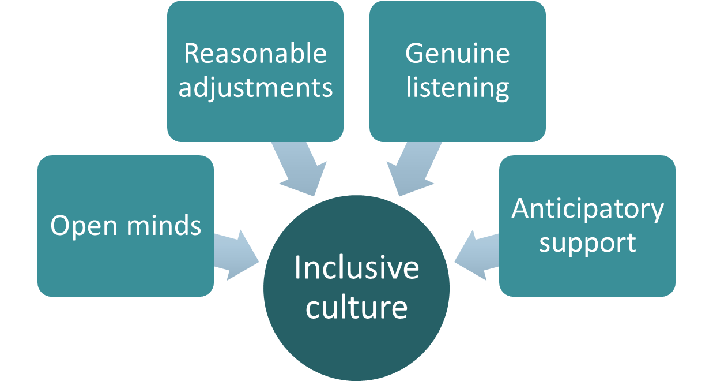
Modelling inclusion
Notes:
Your commitment to the professional values of integrity, trust and respect and social justice should be demonstrated in all aspects of your role as a teacher.
A core component of teachers’ professional commitment is understanding the needs of learners with autism and other additional support needs. GTCS Professional Standards state that teachers should recognise, see and acknowledge the value in everyone and have a deep awareness of the need for culturally responsive pedagogies.
It is the role of teachers to promote equality and diversity, paying careful attention to the needs of learners from diverse groups and in upholding children’s rights.
The Review of Additional Support for Learning Implementation (2020) highlights the importance of all teachers holding and enacting professional values of inclusion and inclusive practice and emphasises that this should be seen as a core part of your role.
All teachers have a duty to critically examine personal and professional attitudes and beliefs and to challenge assumptions and professional practice.
At this early stage of your teaching career, the best way that you can do this is through modelling an inclusive mindset and approach in your own practice.

Slide 6
Parents
  Good communication
  Avoid singling out
  Visual timetables
  Well supported transitions
  Solution focused
Notes:
The need to have an inclusive mindset extends to the whole school community, and this includes parents. Families of autistic learners often report feeling judged, isolated and excluded.
When starting at a new school it will be important to find out what arrangements the school have in place for communicating with parents and what your role is within this. This is likely to vary by local authority and by establishment.
Parents and carers tell us that good communication is key and that this works best when it is planned and consistent – having a regular planned contact rather than school staff getting in touch when something has gone wrong.
Parents regularly ask that they are not approached in the playground in front of other parents – this can lead to them feeling judged or excluded by the other parents.
They tell us that they value consistent use of visual supports and well supported transitions.
Whilst on placement, you may be offered the opportunity to attend/observe individual child planning meetings. This can be a good way to develop an understanding of the 24 hour life of the child.

Slide 7
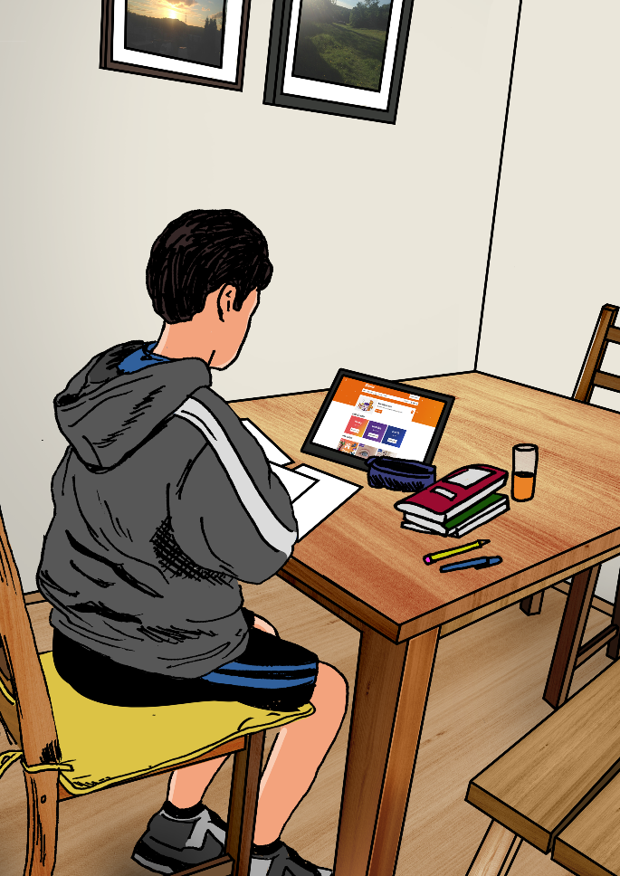
Homework
Notes:
Homework is a common area of concern for autistic learners, particularly at the secondary stage. Some express that ‘work is for school and not for home’ and many are so exhausted by the effort required to get through their school day that they are not able to focus on further work in the evenings and at weekends.
Reasonable adjustments can be made, such as communicating tasks directly to parents to enable them to understand expectations and support their child, reducing or time limiting tasks or chunking work down into manageable sized blocks.
It is important to review regularly and consider the impact of any difficulties arising on both the young person and their family. Ultimately it may be helpful to consider and weigh up the value of any work set against any negative impact experienced. Think DIRM…does it really matter?

Slide 8
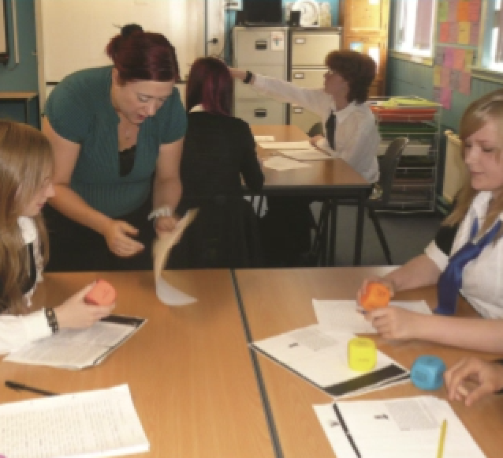
Pupil Support Assistants
Notes:
It is the responsibility of the class teacher to plan experiences and outcomes that take account of the strengths and needs of all learners in their class.
Some classes might have an additional adult in a supporting role and occasionally an adult will be allocated to support the inclusion of one or more identified learners.
The role of a support assistant is to facilitate the participation of a learner with additional support needs and to enable the learner to be as independent as possible within the school environment. Support assistants may or may not have formal training and may or may not have knowledge of particular additional support needs.
Often the best support assistants stand back and observe rather than sit alongside a child doing things for them or prompting them through tasks. They continually look for ways to increase a child or young person’s independence and reduce dependence.
As with any learner with an additional support need, it is important to have a clear plan that all the adults working with an autistic learner follow. A person can implement a plan and use strategies- but a person is not a strategy!

Slide 9
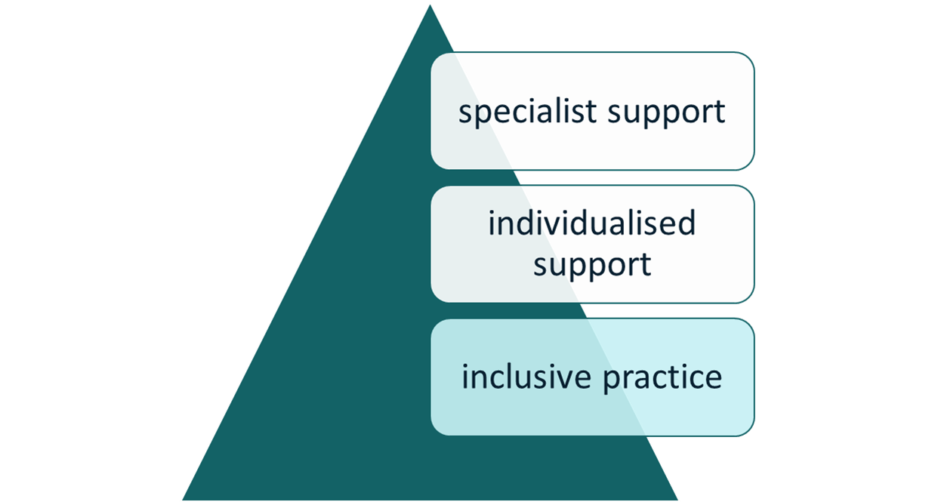
Collaborative working
Notes:
Each local area will have different structures and systems but all in Scotland should work to Getting it right protocols set out in the Additional Support for Learning Act.
Find out how school staff in your area work in partnership with others (e.g. Educational Psychologists, Speech and Language Therapists, Occupational Therapists) at:
Universal
Targeted
and
Specialist levels
Try to find out how the Child Planning process works in your area.
Look for opportunities to shadow, observe, liaise with other professionals working in and with the school and find out about how teams of professionals work together and with parents to support children with additional support needs.
We can all learn from each other. Teachers bring expertise in teaching – others bring different expertise to the team around the child.
It is widely recognised that having a single child’s plan is desirable and beneficial – to get to that point we need to work together!

Slide 10
The inclusive classroom – what about the other children?
  Difference not deficit
  No blame culture
  Every day is a new day
Notes:
You might remember from Unit 1 of the autism course content that 30.9% of the mainstream school population across Scotland have an additional support need. We can all expect to see children with a range of needs in every class we teach.
We all need to take the position that, “We were expecting you!”
When working in schools you might hear other staff members or even other parents ask, “What about the other children?”
Why does the autistic learner get special resources/ equipment?
Why do they get away with (distressed) behaviour?
What about the other children having to experience their (distressed) behaviour?
Everything you say and do can influence how others view a child or young person and the experience that child or young person will have within the school community going forward. You can support the learner, and meet with your responsibilities under the ASL and Equalities Acts by:
Valuing different minds
Making anticipatory reasonable adjustments
Modelling an empathetic response to distressed behaviour
Being conscious of Indirect Discrimination and supporting individuals according to need, rather than treating all equally
Maintaining the confidentiality of individual learners
Modelling a ‘no blame culture’
Reflecting and planning with colleagues
and
Treating every day as a fresh day!

Slide 11
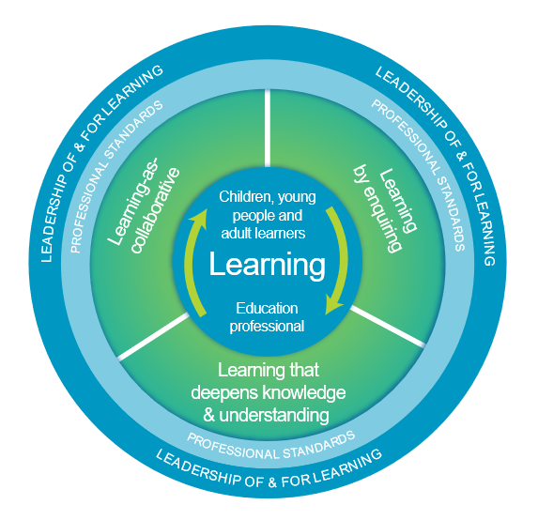

National Model of Professional Learning
Notes:
Professional learning for Scottish teachers across their career is guided by the National Model of Professional Learning.
The model is used alongside self-evaluation activities related to the General Teaching Council for Scotland Professional Standards, to map out each teacher and school’s professional learning.
Professional values detailed in the Professional Standards 2021 have been expanded to ensure greater emphasis on inclusion, equality and diversity.
(Presenter note: Image is Hyperlink to National Model of Professional Learning on Education Scotland website.
https://education.gov.scot/improvement/self-evaluation/a-national-model-of-professional-learning )

Slide 12
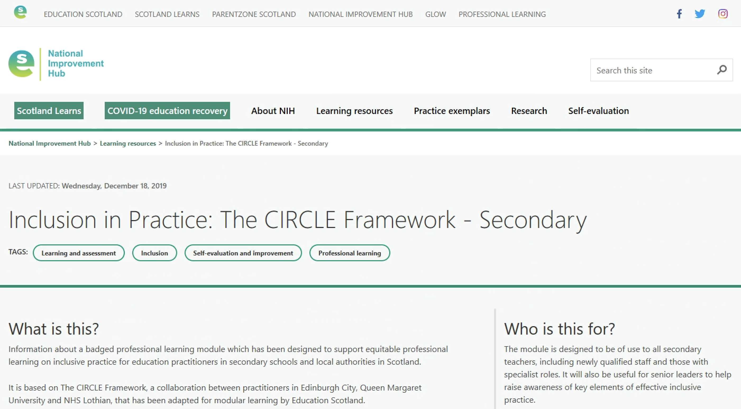
Inclusive Practice Online Module
Notes:
The Inclusive Practice Online Module , developed by Education Scotland and the CIRCLE Team at Queen Margaret University, follows the National Model of Professional Learning which underlines that professional learning should challenge and develop thinking, knowledge, skills and understanding and should be underpinned by developing skills of enquiry and criticality.
(Presenter note: Image is Hyperlink to Education Scotland Inclusion in Practice Online Module
https://education.gov.scot/improvement/learning-resources/inclusion-in-practice# )

Slide 13
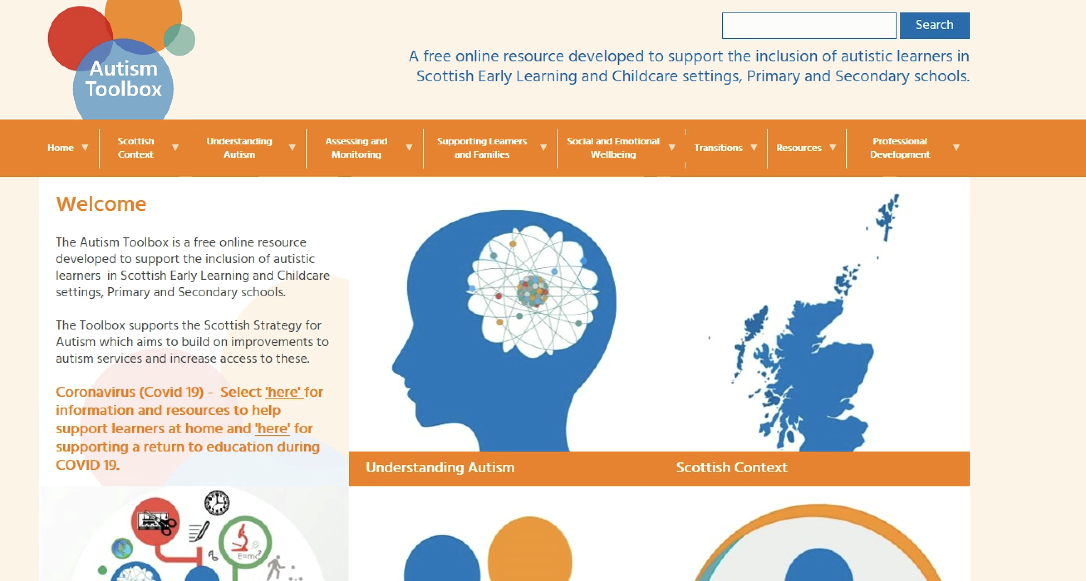
Autismtoolbox.co.uk
Notes:
The Autism Toolbox is a key resource for Scottish teachers to find up to date, evidence based information, guidance, resources and professional learning opportunities. Content is closely linked to Curriculum for Excellence and the Scottish educational context.
The aim of the Toolbox is, “To help staff support autistic learners and their families within the framework of Curriculum for Excellence and the Getting it right for every child approach.”
This resource is funded by the Scottish Government and managed by Education Scotland.
(Presenter note: Image is hyperlink to Autism Toolbox website
http://www.autismtoolbox.co.uk/ )

Slide 14
Key messages
Environment first
Provide predictability
Make learning meaningful
Seek to understand distressed behaviour
Ensure adjustments are anticipatory
Difference, not deficit
‘We were expecting you!’
Notes:
We’ve looked closely at two of the autism Key Messages today but over the course of the year we have explored all seven. Throughout the rest of this course, and in into your teaching career, we ask everyone to keep these Key Messages in mind.

