Slide 1
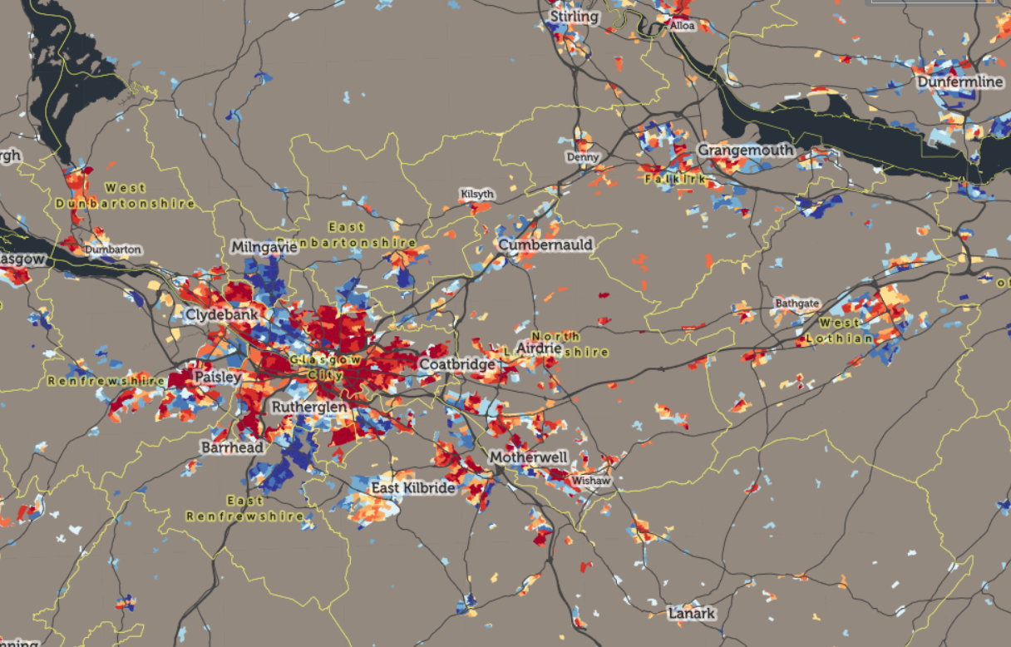
Beyond business as usual: Rethinking teacher education for the Attainment Challenge.
@SACTEdu
Catherine Doherty, Moyra Boland, Stephen Day
for Scottish Council of Deans of Education Forum
8 October, 2019
Notes:
Cast of thousands ..
Thankful for opportunity to talk – because the profession is very much part of teacher education …
The SIMD image ..

Slide 2
The brief
Scottish Council of Deans of Education were invited to develop a research agenda in teacher education to support the Scottish Government’s Attainment Challenge:
To equip early careers teachers (final year ITE and induction year)
to work more effectively
to improve literacy, numeracy and health and wellbeing outcomes
for students in areas of high deprivation.

Slide 3
Scottish Government Attainment Challenge
 | Scottish Council of the Deans of Education research agenda: Developing pedagogies that work for pre-service and early career teachers to reduce the Attainment Gap in literacy, numeracy and health and wellbeing
 | RQ1 AUDIT: What do we in teacher education institutions collectively do currently to support early careers practitioners to work effectively with pupils from SIMD 1-40 backgrounds?
 | RQ2 EVALUATION: Of our current practice, what do we do well and what could we do better?
 | RQ3 RESOURCE: What other practice or research might assist us in our purpose?
 | RQ4 REFORM: How can we improve teacher education so our early career teachers are more effective in improving the engagement and attainment of pupils?
 |  | 8 projects in the participating universities addressing each institutions context and strengths
 |  | 2 (+3) PhD projects

Slide 4
 | Pedagogies for improving inclusion of pupils living in poverty, and the ‘dilemma of difference’;
 | Teaching and learning for equity through communities of practice;
 | Collaborative design of outdoor learning to enrich literacy learning, health and wellbeing;
 | Enriching practitioner enquiry in final year ITE and probationary year with iterative, shared, cumulative learning;
 | The use of school-based evidence by early career teachers in rural areas;
 | Mentoring early career teacher’s professional judgement and innovative pedagogies;
 | Pedagogies in placements, university and employment to enhance literacy, numeracy and health and wellbeing;
 | Early career teachers’ ways of knowledge, meaning-making and reflective practice.
Notes:
Refractions across settings, priorities and strengths/

Slide 5
Literacy, numeracy, health and wellbeing
In our audit of what we currently do
In Strathclyde’s doctoral projects:
June Pisaneschi (EdD P/T)
In which contexts and by what means do early-career primary teachers experience meaningful learning in mathematics?
In UWS project, re data literacy of teacher education students
In other spaces: the practitioner enquiry (University of Glasgow project), assessment tasks offering choice

Slide 6
preparation of teachers in numeracy
the student teachers’ own underpinning content knowledge and confidence in mathematics …. attention to ‘developing positive attitudes towards mathematics’.
building understanding of pupil progression in mathematics, role of prior knowledge and typical misconceptions.
problem-solving, patterning and data use; how to teach by themes; and how to integrate maths content/topics.
inclusive approaches with differentiation by means other than ability grouping.
the language of maths, including in Gaelic for Gaelic-medium settings.
exploring numeracy in the use of gaming theory.
how to teach mathematics’ ‘surgery’ or coaching for students teacher of other subjects
numeracy across the curriculum, particularly in STEM subjects
secondary student teachers are taught about literacy and numeracy acquisition in order to identify difficulties:
the impact numeracy achievement has on the life chances of young people; strategies to support learners who have had reduced literacy and numeracy experiences.
Notes:
Difficulty in making sense of complex array within and across programmes
Broad agenda ..

Slide 7
Food for thought
Numeracy expertise spread thin?
Competing for space in full curriculum, especially PGDE?
Numeracy should perhaps garner more attention given the concern with student teachers’ own confidence in this knowledge and its importance in STEM?
In secondary programmes, the support of pupils with low literacy and numeracy could be given a higher profile, such that the sector produces numeracy-aware graduates?

Slide 8
Other opt-in spaces of opportunity
Assessment that caters for student choice attracts further consideration of numeracy
Practitioner enquiries:
Own maths anxiety as child created interest in making maths work. Saw how engaging active/play-based learning was in very poor school on previous placement. Implemented in own class in next context Talked of numeracy across the curriculum. Observed that transition to symbolic forms still tricky. Pupils avoid pen and paper maths. Concept of growth mind set informs his work with low SIMD communities, building confidence and success. Primary PGDE, Male. (#10)
Notes:
So students’ own fears may be of use …

Slide 9
Exploring final year Initial Teacher Education students’ ways of knowing and meaning-making through professional reflective practice
Stephen Day, Carol Webster and Andrew Killen
School of Education and Social Sciences

Slide 10
1. Background
Shift in educational policy towards evidence-based decision-making within schools (Mandinach, 2012; Schildkamp, Karbautzki, & Vanhoof, 2014; Scottish Government, 2017).
Political pressure on national education systems to account for perceived deficiencies in educational outcomes.
Increased calls for teachers to engage in data-driven decision-making (DDDM).
Some teachers feel threatened by the concept and under prepared to engage in DDDM (Dunn, Airola, Lo, & Garrison, 2013a).

Slide 11
1. Background
Teachers’ attitudes and beliefs towards the use of data is complex.
‘Belief’ describes the ideas that influence teachers’ decision-making regarding pedagogy, classroom behaviour and the way they organise lessons (Beck and Lumpe, 1996).
“When clusters of beliefs are organised around an object or situation and predisposition to action, this holistic organisation becomes an attitude” (Pajares,1992 p.314).

Slide 12
1. Background
Attitude is a complex construct with multiple dimensions that require discrete evaluation since they contribute to varying degrees towards the overall object of attitude, e.g. use of data (Ajzen, 2001).
This research explores the dimensions relating to the domains of cognitive belief (Perceived Relevance, Perceived Difficulty), the affective state (Anxiety, Enjoyment) and perceived control (Self-Efficacy, Context Dependency) (Bandura 2001).
Also, it focuses on the extent to which final year ITE students’ can analyse, interpret and reflect upon educationally relevant (classroom level tracking and monitoring) data

Slide 13
2. Context of the research
Part of a larger exploratory mixed methods approach exploring final year Initial Teacher Education students’ ways of knowing and meaning-making through professional reflective practice.
The preliminary findings of the first year of data collection from the quantitative phase of the research will be outlined in this presentation.

Slide 14
3. Research Questions
Do final year ITE students’ attitudes towards the use of data differ according to programme of study?
What factors impact upon final year ITE students’ attitudes towards the use of data?
Is it possible to improve final year ITE students’ attitudes towards the use of data, through focused teaching sessions?
To what extent can final year ITE students’ analyses and interpret educationally relevant (tracking and monitoring) data as part of their reflective practice

Slide 15
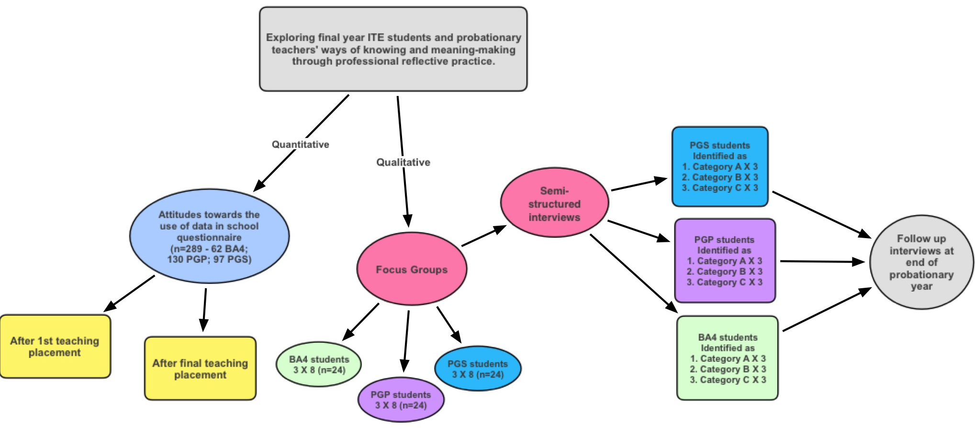
4. Methodology
Today’s
presentation
Year 1
Year 2

Slide 16
4. Methodology
The final year ITE students from three teacher education programmes within one university.
Professional Graduate Diploma Education (Secondary) [PGS n=71];
Professional Graduate Diploma in Education (Primary) [PGP n=110]
Bachelor of Arts (Honours) in Primary Education [BA4 n=49]
A pre/post questionnaire designed to gather information related to the dimensions of attitude towards the use of data within teaching practice was used.

Slide 17
4. Methodology
Six subscales relating to three domains of attitude towards the use of data within teaching practice were –
(1) The Cognitive Belief domain (Perceived Relevance, Perceived Difficulty);
(2) The Affective State (Anxiety, Enjoyment) and
(3) The Perceived Control domain (Self-Efficacy, Context Dependency).
Another two related subscales Effectiveness for Pedagogy and Intentions towards Using Data was also employed.
*Sub-scales were derived from the literature focused on social cognitive theory (Bandura, 2001).

Slide 18
4. Methodology
A sample of PGS students (n=31) where asked to complete a data analysis and interpretation task.
This task was formed of 12 questions relating to a S1 class of 20 pupils end of topic tests score and whole school data relating to pupil performance in literacy, numeracy and by SIMD decile over time.

Slide 19
Attainment data for Class S1 end-of-topic tests taught by teacher X
Pupil Name | Models of Matter (%) | Cells (%) | Periodic table (%) | Electricity (%) | Heat (%) | MEAN | SD
1 | 62.5 | 56.7 | 50.0 | 54.3 | 53.3 | 55.4 | 4.7
2 | 77.5 | 70.0 | 55.0 | 68.6 | 53.3 | 64.9 | 10.4
3 | 30.0 | 50.0 | 50.0 | 57.1 | 60.0 | 49.4 | 11.7
4 | 97.5 | 93.3 | 75.0 | 91.4 | 86.7 | 88.8 | 8.6
5 | 40.0 | 46.7 | 40.0 | 51.4 | 46.7 | 45.0 | 4.9
6 | 100.0 | 96.7 | 55.0 | 94.3 | 86.7 | 86.5 | 18.3
7 | 80.0 | 86.7 | 55.0 | 85.7 | 73.3 | 76.1 | 13.0
8 | 82.5 | 80.0 | 70.0 | 60.0 | 80.0 | 74.5 | 9.4
9 | 82.5 | 86.7 | 75.0 | 82.9 | 86.7 | 82.7 | 4.8
10 | 62.5 | 83.3 | 80.0 | 71.4 | 80.0 | 75.5 | 8.5
11 | 65.0 | 86.7 | 70.0 | 68.6 | 73.3 | 72.7 | 8.4
12 | 55.0 | 73.3 | 65.0 | 65.7 | 80.0 | 67.8 | 9.4
13 | 10.0 | 13.3 | 20.0 | 11.4 | 26.7 | 16.3 | 7.0
14 | 47.5 | 50.0 | 40.0 | 45.7 | 53.3 | 47.3 | 5.0
15 | 70.0 | 66.7 | 60.0 | 65.7 | 60.0 | 64.5 | 4.4
16 | 40.0 | 53.3 | 55.0 | 51.4 | 60.0 | 52.0 | 7.4
17 | 20.0 | 20.0 | 25.0 | 31.4 | 40.0 | 27.3 | 8.5
18 | 27.5 | 66.7 | 60.0 | 42.9 | 53.3 | 50.1 | 15.4
19 | 60.0 | 60.0 | 50.0 | 57.1 | 60.0 | 57.4 | 4.3
20 | 95.0 | 100.0 | 80.0 | 91.4 | 86.7 | 90.6 | 7.7
MEAN | 60.3 | 67.0 | 56.5 | 62.4 | 65.0 | 62.2
SD | 26.3 | 23.8 | 16.6 | 21.1 | 17.4 | 19.9

Slide 20
5. Findings
The reliability was good - Cronbach’s Alpha for each participant group; > 0.75 with PGS [0.904], PGP [0.84] and BA4 [0.85].
Significant correlations between PGP (F= 7.724, p=0.006) and BA4 (F= 5.067, p=0.029) participants levels of Anxiety v Self Efficacy
No significant correlation in PGS participants (F= 0.635, p=428).

Slide 21
Questions probes students ability to analyse the data where as follows…
What information does this data provide regarding the attainment of class? Explain your answer
Which topic do the class understanding best? Explain your answer
Which topic do the class understand least? Explain your answer
Examining Table 2, answer each question by stating your view and explaining your thinking
Which pupil is top of the class?
Which pupil is bottom of the class?
Reflecting upon the data in Table 2, if this were your class, what does this data suggests about …
Pupils’ attainment?
Your teaching?

Slide 22
5. Findings
Highly significant correlations for Self Efficacy v Context Dependency within the three groups (PGP, F= 25.262, p<0.0001; PGS, F= 65.647, p<0.0001 and BA4, F= 12.971 p= 0.001).
No significant correlation between Anxiety v Enjoyment with PGS (F= 1.304, p=0.257) and BA4 (F= 1.009, p=0.320) participants;
Significant correlation with PGP participants (F= 16.634, p<0.0001).

Slide 23
Figure 1: Scatterplot showing the distribution of scores of final year ITE Students Anxiety and Self-Efficacy
Note: Panel A shows a scatterplot for PGS participants (n=71). Panel B shows a scatterplot of PGP participants (n=110). Panel C shows a scatterplot for the BA4 participants (n=49). Dashed lines reflect the cut-off point for the quartiles, Self-Efficacy (SE) >3 is quartile 1 and 2; SE ≤ 3 is quartile 3 and 4; Anxiety ≥ 3 is quartile 2 and 3; Anxiety < 3 is quartile 1 and 4. Q1= High potentials; Q2= Promising; Q3= reluctant; Q4= indifferent.

Slide 24
Figure 2: Scatterplot showing the distribution of mean scores for final year ITE students’ Context Dependency and Self Efficacy
Note: Panel A shows a scatterplot for PGS participants (n=71). Panel B shows a scatterplot of PGP participants (n=110). Panel C shows a scatterplot for the BA4 participants (n=49). Dashed lines reflect the cut-off point for the quartiles, Self-Efficacy >3 is quartile 1 and 2; Self-Efficacy ≤ 3 is quartile 3 and 4; PD ≥ 3 is quartile 2 and 3; PD < 3 is quartile 1 and 4. Q1= High potentials; Q2= Promising; Q3= reluctant; Q4= indifferent.

Slide 25
Table 1: Comparison between the subscale mean (± Standard Deviation) scores for PGS, PGP and BA4.
Sub-scale | PGS |  | PGP |  | BA4
 | Pre | Post | Pre | Post | Pre | Post
Self-Efficacy | 3.49 (0.62) | 3.56 (0.51) | 3.20 (0.52) | 3.55 (058)* | 3.56 (0.51) | 3.69 (0.47)
Anxiety | 2.68 (0.85) | 2.60 (0.79) | 2.93 (0.85) | 3.01 (0.75) | 2.60 (0.79) | 3.19 (0.86)*
Enjoyment | 2.98 (0.87) | 2.95 (0.84) | 2.64 (0.71) | 2.73 (0.75) | 2.95 (0.84) | 2.87 (0.67)
Perceived Context Dependency | 3.05 (0.49) | 3.27 (0.59)* | 3.10 (0.44) | 3.36 (0.57)* | 3.27 (0.59) | 3.46 (0.54)#
Relevance | 3.87 (0.66) | 3.76 (0.60) | 3.88 (0.54 | 3.80 (0.65) | 3.76 (0.60) | 3.97 (0.56)
Difficulty | 3.42 (0.79) | 3.14 (0.80)* | 3.45 (0.72) | 3.42 (0.56) | 3.13 (0.80) | 3.55 (0.73)*
Data Effectiveness for Pedagogy | 3.64 (0.78) | 3.54 (0.67) | 3.77 (0.55) | 3.75 (0.52) | 3.54 (0.67) | 3.97 (0.46)*
Intention to use data | 4.04 (0.72) | 3.95 (0.67) | 4.06 (0.50) | 4.01 (0.53) | 3.95 (0.67) | 4.18 (0.44)*
Sig diff p>0.05 pre v post for a two-tailed t-Test
# ns p=0.06 pre v post for a two tailed t-Test

Slide 26
5. Findings – Final Year ITE Students ability to analyse and interpret classroom level data
Only 42% of the sample scored ≥50% with 58% of the sample scored < 50%.
42% of the sample could not correctly identify the topic that was best understood by the class, with 58% being able to correctly identify correct the best understood topic.
Where as 87% of the sample could identify the least understood topic with 13% not being able to identify the least understood topic.
However, only 5% of those able to correctly identified the best topic could fully explain their reasoning for their choice with 95% being partly able to explain their reasoning.
Whereas, 15% of those that correctly identified the least well understood could fully explain there choice with 85% could partly explain their choice.

Slide 27
5. Findings – Final Year ITE Students ability to analyse and interpret classroom level data
In terms of data interpretation…
83.9% of the sample struggled to make more that 2 meaningful comments about the attainment of the class with 13% of these being unable to make any meaningful comments.
16.1% of the sample were able to make 3 or more meaningful comments about the attainment of the class .
71% of the sample struggled to make more than 2 meaningful comments about what this data might suggest about their teaching with 13% of these being unable to make any meaningful comments.
25.8% of the sample being able to make 3 or more comments with regards to what the data might say about their teaching.

Slide 28
6. Conclusion
RQ1. Do final year ITE students’ attitude towards the use of data differ according to programme of study?
Yes, significant differences in students’ attitude profiles according to programme of study.
High Potential category data indicates that a higher proportion of PGS and BA4 students have High Self Efficacy and Low Anxiety towards the use of data compared to PGP students.
However, 65.9% of BA4 and 56.9% of PGS students are promising in that they have High Self-Efficacy and High Context Dependency compared to 33.3% PGP students.

Slide 29
6. Conclusion
RQ2. What factors impact upon final year ITE students’ attitudes towards the use of data?
Context dependency is an important factor in determining attitude towards the intention to use data within their reflective practice.
Further statistical modelling is required to determine the relationship the relative importance of the different elements of the theoretical model used to profile student teachers confidence in using data within their teaching practice.
It is unsurprising that context dependency is emerging as an important element of attitude given the social nature of teaching and the factors that impact on many activities relating to classroom practice.

Slide 30
6. Conclusion
RQ3. Is it possible to improve final year ITE students’ attitudes towards the use of data, through focused teaching sessions?
Data from Table 1 indicates that it is possible to make modest shifts towards improving ITE students attitude towards the use of data within their teaching practice.
However, just because attitudes can shift towards being more Promising and High Potential in terms of Cognitive Belief, Affective State and Perceived Control, the ability to use data is a different prospect.

Slide 31
6. Conclusion
RQ4. To what extent can final year ITE students’ analyses and interpret educationally relevant (tracking and monitoring) data as part of their reflective practice.
Even final year students with a High Self-Efficacy and an epistemological background steeped in data handling and analysis struggle to analyse educationally relevant data.
58% of the sample scored <50% in the data analysis and interpretation task which suggests that they could not effectively analyse classroom level data.
Even those that could score above ≥50% in the data analysis and interpretation task were weak in terms of making simple observation about the data.
This suggests that final year ITE students need support to engage in effective analysis and interpretation of classroom level data.

Slide 32
Thank you for listening…
stephen.day@uws.ac.uk
@StephenPaulDay
@SACTEdu

Slide 33
References
Ajzen, I. (2001). Nature and operation of attitudes. Annual Review of Psychology, 52, 27–58.
Bandura, A. (2001). Social cognitive theory: An agentic perspective. Annual review of psychology, 52(1), 1-26.
Beck, J. A. and Lumpe, A. T. (1996) Teachers’ Beliefs and the implementation of personal relevance in the classroom, Paper presented at the Annual Meeting of the Association for the Education of Teachers in Science, Seattle.
Dunn, K. E., Airola, D. T., Lo, W. J., & Garrison, M. (2013a). Becoming data driven: The influence of teachers’ sense of efficacy on concerns related to data-driven decision making. The Journal of Experimental Education, 81 (2), 222-241.
Dunn, K. E., Airola, D. T., & Garrison, M. (2013b). Concerns, knowledge, and efficacy: An application of the teacher change model to data driven decision-making professional development. Creative Education, 4 (10), 673.
Mandinach, E. B (2012). A Perfect Time for Data Use: Using Data-Driven Decision Making to Inform Practice, Educational Psychologist, 47 (2), 71-85.
Pajares, M. F. (1992). Teachers’ beliefs and educational research: Cleaning up a messy construct. Review of Educational Research, 62, 307–332
Schildkamp, K., & Ehren, M. (2013). From “Intuition”-to “Data”-based Decision Making in Dutch Secondary Schools? In Data-based decision making in Education (pp. 49-67). Springer, Dordrecht.
Schildkamp, K., Karbautzki, L., & Vanhoof, J. (2014). Exploring data use practices around Europe: Identifying enablers and barriers. Studies in educational evaluation, 42, 15-24.
Scottish Government (2017) National Improvement Framework and improvement plan for Scottish education. (Available online) https://www.gov.scot/publications/2017-national-improvement-framework-improvement-plan/ [Last Accessed 26th Jan 2019]

