Slide 1

Autism Unit 1:
We were expecting you!
Initial Teacher Education Autism Course Content
Notes:
The Scottish Autism Pre-recorded lecture that accompanies this Unit can be found here: https://youtu.be/4g6spWla9hE

Slide 2
Authorship
This unit belongs to a suite of resources developed by a Scottish Government working group including representation from:
Learning Directorate, Scottish Government
National Autism Implementation Team
Education Scotland
University of Strathclyde
General Teaching Council for Scotland
COSLA
ADES
Autistic individuals
Scottish Autism
National Autistic Society
Scottish Council of University Deans
These slides should not be reproduced or used without permission.
Notes:
(Presenter note: No need to read out. Will be included as part of PPT if shared electronically.)

Slide 3
Plan
Key Messages
Legislative context
Why autism?
Anticipatory support
Inclusive practice
Environment first
Staged intervention
Key Messages
Notes:
(Presenter note: Read only – do not expand at this point)
The plan for today is:
Key Messages
Legislative context
Why autism?
Anticipatory support
Inclusive practice
Environment first
Staged intervention
Key Messages

Slide 4
Key messages
Environment first
Provide predictability
Make learning meaningful
Seek to understand distressed behaviour
Ensure adjustments are anticipatory
Difference, not deficit
‘We were expecting you!’
Notes:
All four units of the autism course content will be focussing on these seven Key Messages.
We introduce them today as we set the scene with Autism Unit 1 and will explore them in greater detail as the course progresses.
This presentation will highlight each Key Message as we go through, with the symbol in the top right corner.
This Unit will place a particular focus on:
Ensure adjustments are anticipatory
Difference, not deficit
and
‘We were expecting you!’
We hope that this is just the start of your autism learning - that you will become enthused to keep reading and learning.
Throughout this course we ask that everyone keep these 7 Key Messages in mind. If you only take seven messages from the autism course content, let it be these…

Slide 5
Legislative context
Standards in Schools Act 2000
Accessibility Strategy (Scotland) Act 2002
Additional Support for Learning Act 2004 (as amended)
Equality Act 2010
Children and Young People (Scotland) Act 2014
Education (Scotland) Act 2016
Draft Education (Scotland) Bill 2018
Notes:
Scotland has a wide range of legislation to support inclusion and equality in education. This is not an exhaustive list.
These promote a child centred approach to encourage every child to reach their ‘fullest potential’. The legislation ensures rights and entitlements for children and young people to education, support and wellbeing.
Together with educational policies, they place duties and expectations on schools and local authorities to ensure that they:
Deliver an inclusive education
Support learners to achieve to the best of their ability
Do not discriminate against those with protected characteristics
Provide assessments when requested

Slide 6
Policy
Curriculum for Excellence
Getting it Right for Every Child
Included Engaged Involved (Pt1 and Pt2)
Scottish Attainment Challenge
National Improvement Framework
Delivering Excellence and Equity in Scottish Education:
    A Delivery Plan for Scotland
Supported by:
How Good is Our School 4
GTCS Framework for Professional Standards
Notes:
Children’s rights and entitlements are fundamental to Scotland’s approach to inclusive education.
They are supported by policy drivers including, Curriculum for Excellence, the Getting it right for every child approach and the Framework for Professional Standards for teachers.
These are underpinned by a set of values aligned to social justice and commitment to inclusive education.
We are sure you will already be familiar with these.

Slide 7
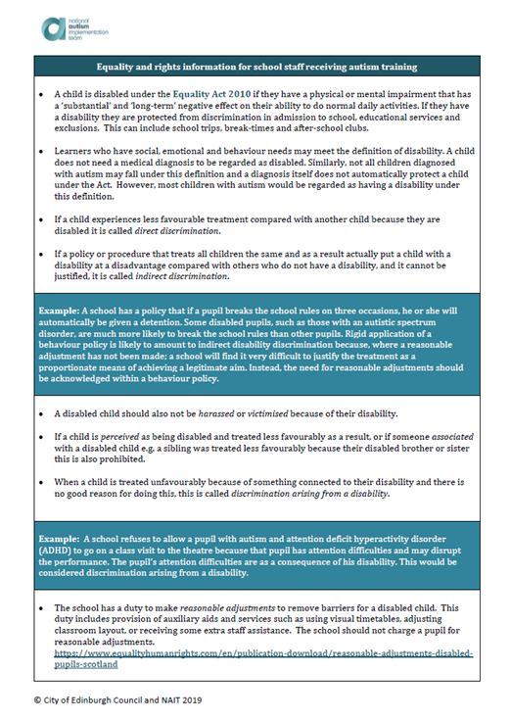
Adjustments are anticipatory
Equality Act 2010
Direct discrimination
Indirect discrimination
Discrimination by association
We have a duty to make reasonable adjustments
www.thirdspace.scot/NAIT
Notes:
The National Autism Implementation Team have created an autism specific guide to the Equality Act (2010). This can be found on the NAIT website.
Please take time to read this following the training and, ideally, to discuss with peers.
For now we would like to draw your attention to 4 elements:
Direct Discrimination – This refers to treating someone differently because of one of the 9 protected characteristics; in this case disability. (In most cases, autism would be considered to be a disability). We all tend to be conscious of Direct Discrimination and of the importance of not discriminating.
Indirect Discrimination – (Trainer note: read quote from the handout) “If a policy or procedure that treats all children the same and as a result actually put a child with a disability at a disadvantage compared with others who do not have a disability, and it cannot be justified, it is called indirect discrimination.”
Sometimes, with best intentions, we might try to treat everyone the same and to insist that everyone in the class is expected to take part in something that, for reason of their disability, autistic children might not be able to do without significant adjustment.
For example:
Elements of Restorative Practice require children to have well developed Theory of Mind and social imagination, both of which are recognised areas of difference in autism.
Collaborative Group work, Sports Day and School Camp/ Residential Visits may all need to have reasonable adjustments made to them in order for autistic children and young people to be able to participate meaningfully.
Discrimination by Association – This refers to the people around the child or young person, e.g. their parents and siblings.
We need to ensure that we do not have different expectations of parents of children with a disability.
Do we expect parents of autistic children to come on trips with their child when we do not expect this of other parents?
Do we expect parents of autistic children to come to the school and collect them in the middle of the school day?
Do we expect them to have their child at home for part of the week when we do not expect this of parents of a child without a disability?
Do we expect siblings to support their brother or sister in a more regular or intense way than we might expect of other siblings in school?
Finally, the Act is clear that we need to make ‘Reasonable Adjustments’ to meet the needs of children with a disability. It also states that these adjustments must be anticipatory – we can’t just wait to see how things go!

Slide 8
Equalities in schools
https://youtu.be/5hR1KEYIbzc
Notes:
(Presenter note: Link to Education Scotland YouTube site to a 6 minute film about Autism and the Equality Act in Scotland’s schools
https://youtu.be/5hR1KEYIbzc )

Slide 9
Why autism?
1 – 1.5% of children have autism ⁽¹⁾
86% of autistic children attend mainstream schools ⁽²⁾
4.6% of exclusions in Scotland ⁽³⁾
68% of tribunals (2017-18) ⁽⁴⁾
30.9% of children have an additional support need ⁽⁵⁾
Good autism practice benefits all children
Notes:
Just in case anyone here is still wondering….why is there a focus on autism?
All teachers will come across children with autism in their class and they account for more of the challenges reported than other ASNs
We know that …
1 – 1.5% of children have autism
86% of autistic children attend mainstream schools
4.6% of exclusions in Scotland are of autistic learners
68% of tribunals (2017-18) relate to autistic learners
30.9% of children have an additional support need – so we need to know that everybody from probationer teachers through to regional experts and authority lead expects that children with autism will be in a mainstream class.
We also know that:
Good autism practice benefits all children.

Slide 10
Additional support needs
192 115 mainstream primary and secondary pupils with reason for support recorded (2018)
14 810 mainstream primary and secondary pupils with autism recorded (2018)
Notes:
Children with identified Additional Support Needs have wide and varied needs.
Here are the number of autistic children recorded in mainstream schools in Scotland, from 2018.
There is no expectation that staff will be experts in how to deal with every Additional Support Need, however….. (click for next slide)

Slide 11
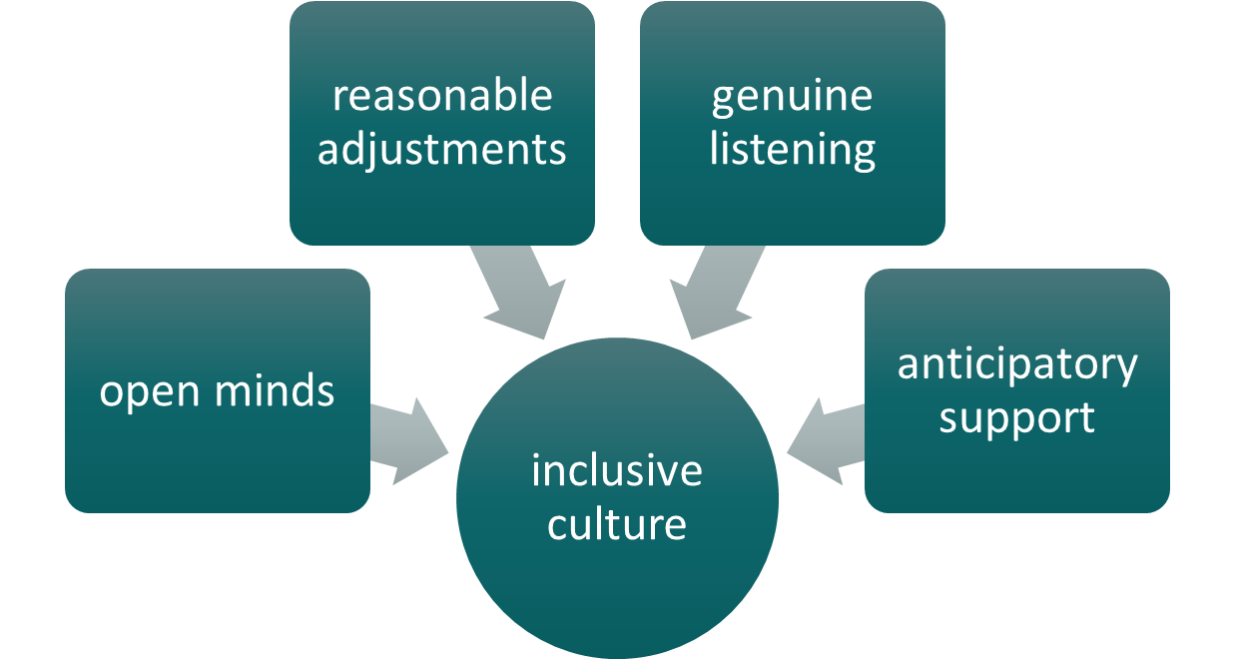
We were expecting you
Notes:
…’We were expecting you’ is a really important Key Message.
In Scotland the policy and legislation strongly support inclusion and it is our shared responsibility to implement this through an inclusive culture.
We’ve not got it right for everyone yet.
We won’t always know what to do but we can come at a challenge with an open mind, willing to do things differently and genuinely listening to children and their families.
30.9% of the mainstream school population across Scotland have an additional support need of some kind.⁽⁵⁾ We can all expect to see children with a range of needs in every class we teach.
We need to know that everybody from Probationer Teachers through to Authority Leads expects that children with autism will be in a mainstream class and we all need to take the position that, “We were expecting you!”

Slide 12
Inclusive practice: staged intervention
specialist support
individualised support
inclusive practice
Notes:
Good inclusive practice sits within a staged intervention model.
Staged intervention is the national approach to creating an inclusive school environment that seeks to meet the needs of everyone. For many autistic children, their needs will be well met in an inclusive mainstream environment.
For some learners who require a more tailored approach, the Getting it right Child Planning Process will support individualised planning via the ‘team around the child’.
And for a smaller number of learners, specialists from Education and Health may be required to support planning (e.g. Outreach Teachers, Speech and Language Therapists and Occupational Therapists).
The highest level of support is often provided in special schools and classes.
For all children, staged intervention provides a foundation for good inclusive practice in supporting all children with additional support needs, including autistic children.
In Scotland support is led by need, not diagnosis.
Understanding of support needs can be enhanced by diagnosis but should not wait for diagnosis.

Slide 13


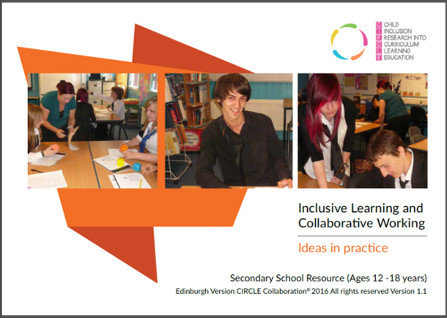
The CIRCLE Framework
www.thirdpace.scot/NAIT
Notes:
One way of approaching Inclusive Practice is provided by The CIRCLE Framework.
CIRCLE provides evidence based resources, developed through extensive qualitative research with teachers to define best universal practice for inclusion in schools and nurseries.
These free to download resources are available on the Autism Toolbox Website and on the National Autism Implementation Team website:
www.thirdpace.scot/NAIT
Education Scotland have created a badged online module of the Secondary Module and a module for the Primary resource is planned.

Slide 14
Environment first
Environment
Structures and routines
Motivation
Skills
Notes:
CIRCLE tells us that, when we recognise a need and are looking for ways to support, we should first consider:
Adaptations to the physical and social environment
Creating clear and predictable structures and routines
Ensuring that motivation is intrinsic to the task or activity – that a child knows why they are expected to do something and that it is meaningful to them
Only when all of these things are in place should we look to develop the child’s skills
E.g. If a child isn’t regularly initiating or asking for help, just telling them the words to say and teaching them to say, “I need help” won’t change this… unless:
The child’s day is set up to provide opportunities (routine and structure), the child has a reason to ask (motivation) and the people around them are supportive of and responsive to request attempts (adapted social environment).
CIRCLE is a good first point of information and support for anyone in schools seeking to meet the needs of autistic learners.

Slide 15
Staged intervention
specialist support
individualised support
inclusive practice
Notes:
Early stages of support happen in the classroom and wider school and the CIRCLE resources are designed to support inclusive practice at these stages.
As a child’s support needs move through the stages, CIRCLE is still relevant. Big problems don’t always require big solutions. It’s important to keep checking that the basics are in place.

Slide 16
Key messages
Environment first
Provide predictability
Make learning meaningful
Seek to understand distressed behaviour
Ensure adjustments are anticipatory
Difference, not deficit
‘We were expecting you!’
Notes:
Throughout the rest of this course we ask everyone to keep these Key Messages in mind. We’ve looked closely at 3 of them today. We will build on this in the next 3 Autism Units.

Slide 17
References
⁽¹⁾ SIGN 145 Assessment, diagnosis and interventions for autism spectrum disorders, 2016 https://www.sign.ac.uk/assets/sign145.pdf
⁽²⁾ Not Included, Not Engaged, Not Involved, published online, 2018 https://www.notengaged.com/
⁽³⁾ Scottish Government School Exclusions Statistics, published online, 2018-19 https://www.gov.scot/publications/school-exclusion-statistics/
⁽⁴⁾ M Dunsmuir (Chamber President of the Additional Support Needs Tribunal for Scotland) Additional Support for Learning Summit, oral presentation, 2019
⁽⁵⁾ Review of Additional Support for Learning Implementation, Crown Copyright, 2020 https://www.gov.scot/publications/review-additional-support-learning-implementation/

