Slide 1

Autism Unit 2:
The profile of autism
Initial Teacher Education Autism Course Content

Slide 2
Authorship
This unit belongs to a suite of resources developed by a Scottish Government working group including representation from:
Learning Directorate, Scottish Government
National Autism Implementation Team
Education Scotland
University of Strathclyde
General Teaching Council for Scotland
COSLA
ADES
Autistic individuals
Scottish Autism
National Autistic Society
Scottish Council of University Deans
These slides should not be reproduced or used without permission.
Notes:
(Presenter note: No need to read out. Will be included as part of PPT if shared electronically.)

Slide 3
Plan
Key Messages
The profile of autism
Cognitive theories
Teacher mindset
Inclusive classroom practice
Supporting peer interactions
Key Messages
Notes:
(Presenter note: Read only – do not expand at this point)
The plan for today is:
Key Messages
The profile of autism
Cognitive theories
Teacher mindset
Inclusive classroom practice
Supporting peer interactions
Key Messages

Slide 4
Key messages
Environment first
Provide predictability
Make learning meaningful
Seek to understand distressed behaviour
Ensure adjustments are anticipatory
Difference, not deficit
‘We were expecting you!’
Notes:
All four units of the autism course content will be focussing on these seven Key Messages.
We set the scene in Autism Unit 1 by looking closely at:
Ensure adjustments are anticipatory
Difference, not deficit
and
‘We were expecting you!’
Today we will give particular focus to:
Environment first
Provide predictability
and
Make learning meaningful
We will continue to explore each of these in greater detail as the course progresses.
As before, this presentation will highlight each Key Message as we go through, with the symbol in the top right corner.
We hope that this is just the start of your autism learning - that you will become enthused to keep reading and learning.
Throughout this course we ask that everyone keep these seven Key Messages in mind. If you only take seven messages from the autism course content, let it be these…

Slide 5
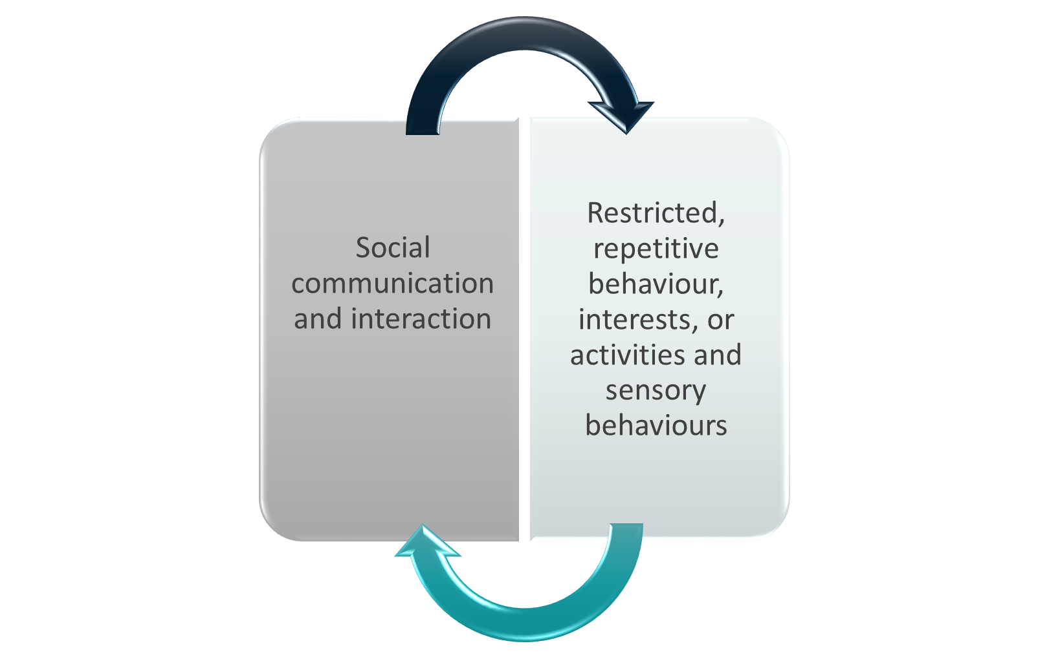
Autism diagnosis in DSM 5
Notes:
Autism is the commonest developmental difficulty in childhood, which is considered to be lifelong and present from birth.
Recent estimates suggest that 1/88 children have autism.
Autism Spectrum Disorder is diagnosed using international criteria called DSM 5.
The diagnostic term describes individuals who present with core differences in two key areas, which are having an effect on daily functioning.
Firstly differences in social communication and interaction.
And secondly differences regarding Restricted Repetitive Behaviours, interests or activities and sensory behaviours.
Children present very differently at different ages and stages – that’s why it’s called a spectrum.
Although the autism signs and symptoms are listed in the diagnostic criteria, there is no such thing as an autistic behaviour and these differences are reflected in the neurodiversity in our society.

Slide 6
What do you see?
Communication
Understanding language
Using social communication
Sensory
Hyper - reactivity
Imagination
Play
Social imagination
Non verbal
Expression (how and why)
Understanding social interaction
Hypo – reactivity
Particular interests in aspects of the sensory environment
Problem solving
Predicting
Dealing with change
Taking things literally
Notes:
Communication
We might see difficulties with understanding vocabulary, grammar and connected language or difficulties forming how and what to communicate to express a wide range of needs and social functions.
In particular autistic people use and understand social communication differently, this might include difficulty noticing and interpreting subtle messages shared through joint attention and non verbal communication.
Communication with peers can be particularly affected as peers may be less able to adapt than older children or adults.
Sensory
Most people would say they have 5 senses (vision, hearing, taste, smell and touch). There are at least a further 3 (one is body position, a second is movement, a third is our internal sensation). Any of these may be processed differently and we might see a child have a strong reaction or under-reacting to some sensations. This might change on different days or in different places.
Imagination
Differences in imagination affect individuals in different ways over time. Early on we might notice play is more concrete and imaginative play is less motivating. Some might go on to develop good fantasy play and there are very many creative autistic people. It’s not the case that all autistic people don’t have imagination. However we might notice differences in using social imagination to predict how people will behave or what will happen in a new situation. Imagination for social problem solving can be affected. We also might notice autistic people have a literal way of understanding language.

Slide 7
Sensory differences
https://youtu.be/PA7F8LBG4Iw
Notes:
The clip we are about to watch is available on the Autism Toolbox. Mel, an Occupational Therapist, gives a helpful overview of Sensory Differences in autism. The clip is 5 minutes long.
(Presenter note: Mel’s film clip from the Autism Toolbox - http://www.autismtoolbox.co.uk/autism-lense-policy-and-legislation
https://youtu.be/PA7F8LBG4Iw )

Slide 8
Make learning meaningful
Before words
Emerging language
Conversation level
Developmental stages
Notes:
The most common reason for the behaviours that we see are the mismatch between expectations and the child’s developmental stage.
It is important that we match activities and our expectations to the child’s level, to make learning meaningful.
Would you expect a 2 year old to collaborate in a group on a task for 20 minutes?
So if you have a learner who is developmentally at that stage in their social development – what might you expect them to do? And how might you make learning meaningful for them?
These are the kinds of questions you need to ask yourself as a teacher.

Slide 9
Cognitive theories of autism
Theory
Theory of mind
Executive function
Weak central coherence
Context blindness
Double empathy problem
Monotropism
Notes:
There are a range of cognitive theories seeking to explain what we see in autism. These are some of the well known ones.
There is a Cognitive Theories document on the NAIT website which gives more information about each.
We are going to look briefly at the first few, think about what we might notice, how you might think about what you see and consider what we might do that could be supportive.
(Presenter note: NAIT Cognitive Theories Resource: https://www.thirdspace.scot//wp-content/uploads/2019/11/NAIT-Cognitive-Theories-Summary-November-2019.pdf )

Slide 10
Theory of mind
Theory of
Mind
Thoughts
Beliefs
Feelings
Experiences
Notes:
We develop Theory of Mind around the age of five years, when we understand other people’s thoughts, feelings, beliefs and experiences – even when they don’t tell us.
In autism this ability does not develop in the same way. It can help us to understand why some autistic children report difficulties or misunderstandings in social interaction.

Slide 11
What might we notice?
The child might:
Tell others what to do
Seem ‘cheeky’
Push to the front of the line
Not follow instructions for ‘everyone’
Not seek approval
Not notice when you are disappointed
Appear selfish
Notes:
These are some common things teachers notice.
Autistic learners might tell others what to do because they may not have a clear understanding of the difference between the role of a teacher and a child. For this reason they may also seem cheeky.
They might push to the front of the line because they want to be first and they don’t understand that other people might also want to be first.
The meaning of ‘everyone’ changes with context. When I first arrived today, everyone was two of us in the room/ online setting up. Now everyone is (however many people in lecture) people. Throughout this presentation, ‘everyone’ will change several times as people arrive late, go to the loo, or pop out to take a phone call.
If the child is having difficulty interpreting other people’s thoughts and feelings, they are unlikely to try to influence their thoughts and feelings or to seek their approval.
Some learners might seek approval but they might not seek it in a way you would expect.
Similarly they might not notice your feelings. You might be putting on your best ‘disappointed’ face and tone of voice to the class and the autistic learner may not pick this up.
Although an autistic learner might appear selfish, this is unlikely to be intentional. If you’re focussed on different things in a situation, you might not pick up on what others would prefer or expect.

Slide 12

What mindset will help?
The adult might think:
Don’t take it personally
DIRM
Why? Why? Why?
Difference not deficit
How can I adapt my communication?
Environment first
Is the learning meaningful?
Notes:
When we notice these things, the solutions lie largely with the people around the child (the social environment).
Our mindset is really important and can influence whether a child feels included and is able to participate in school, so what should that be?
The first thing to consider is that the child is unlikely to be doing this to be deliberately defiant. The child is likely to have their own reason for the behaviour, which might be motivated by what’s uppermost in their own thoughts and desires.
They are not likely to be deliberately trying to have an effect on your thoughts and emotions, so we can remember not to take it personally.
The next thing we can think about is Chris Gillberg’s advice –DIRM (Does it really matter?)….. Is this ‘the hill you want to die on’ or can you let it go?
If this is something that does need consideration, you need to work out the reason for what’s happened. Barry Prizant’s book ‘Uniquely Human’ has a great chapter entitled ‘Why? Why? Why?’ which explains this in more detail.
His book also reminds people that some people think differently and that’s okay.
We might also think about whether we can adapt our own communication, the physical and social environment or the opportunities being provided to make learning meaningful.

Slide 13
What can we do?
Cue the child in by name
Explain ‘everyone’
Create a predictable environment
Respond in predictable ways
Use visuals to support words
Exaggerate emotional responses
Tell the child what you are thinking
Find out what motivates them
Share attention - join the child in their chosen activity
Notes:
These are things you could do but what you should do will depend on the developmental stage of the particular child.
Ros Blackburn (an autistic adult) tells us that unless people use her name when they start to talk to her, she has no idea they are talking to her. We recommend ‘Name pause verb’ e.g. “Anna, [pause] give out these jotters.”
Explain ‘everyone’ … ‘everyone is all the people in the room’; ‘everyone is Jo, Alan, Michael, Sara and Sam’ ‘Oh, Alan has left the room so now everyone is Jo, Michael, Sara and Sam.’ Repeat ad nauseum!
Children are more likely to follow expected social rules, when the environment and routines are predictable and they can anticipate what is going to happen.
Visuals are permanent and help us to simplify our words to help children understand. These can be symbols, pictures or objects.
When children do not pick up on our nonverbal communication, we can highlight important information by telling them explicitly what we want them to know or exaggerating key information.
Children are more likely to engage positively if we consider their motivations and share attention on things that are important to them.

Slide 14
Executive function
Executive Functioning
Plan
Organise
Sequence
Control impulses
Notes:
Our Executive Functioning is our ability to plan, organise and sequence thoughts and actions and to control impulses. It develops over time.
When we become anxious our ability to use these skills reduces.

Slide 15
What might we notice?
The child may:
Seem inconsistent
Have trouble getting started
Need processing time
Take time to plan movements
Be anxious about finishing
Avoid new tasks
Have difficulty working through several tasks
Have difficulty changing for gym
Get into trouble for impulsive behaviours
Regret their response
Notes:
These are some common things teachers notice.
You might be starting to think that these theories and examples are not exclusive to autistic learners…and you would be right. These theories can be applied to children with a wide range of Additional Support Needs. As we mentioned earlier, there is no such thing as an autistic behaviour- these differences are reflected in the neurodiversity in society.
Some learners might appear to be able to do something one day and not the next, or can do it at school but not at home. As the context changes or the child’s level of anxiety rises, their ability to function can be affected.
To begin a task, we need to know the first step and then the next steps in sequence. This requires us to plan, organise and sequence activities. For everyone, these skills are affected by context and levels of anxiety.
Before starting an activity, an autistic learner may need extra thinking time to process instructions and plan their movements.
Sometimes a child can be so anxious about finishing a task that they are unable to get started. They may avoid new tasks altogether.
As teachers we frequently give a sequence or list of instructions to children. Each child needs to use working memory to retain all of the instructions and to switch between tasks. For children for whom working memory is affected, this can lead to feeling overwhelmed and even to ‘switching off’.
It is often during changing time for PE that Executive Functioning difficulties become most apparent. You might notice a child having one shoe off and trousers pulled down, whilst trying to pull their sweatshirt over their head.
Some learners display impulsive behaviours, leading them to get into trouble and often resulting in an immediate feeling of regret.

Slide 16
What mindset will help?
The adult might think:
Don’t take it personally
DIRM
Why? Why? Why?
Difference not deficit
How can I adapt my communication?
Environment first
Is the learning meaningful?
Notes:
Again we need to remember that it’s not personal, each child thinks differently and has different needs and we need to think about whether we can adapt our own communication, the physical and social environment or the opportunities being provided to make learning meaningful.
Does the child need more time?
How can I break this task down?
What visual and learning supports might be helpful?
Is the task meaningful to the child?

Slide 17
What can we do?
Break down tasks into clearly identifiable steps
Chunk tasks
Create routines
Give thinking time
Sequence events and routines
Use timers
Support understanding of time by using photos etc.
Use line up feet/ rope/ numbers
Give instructions in the order they are to happen
Think DIRM
Notes:
Again, there are many things you could do but what you should do will depend on the developmental stage of the particular child.
Chunking tasks down into easily manageable steps and giving instructions one a time is generally helpful. In the early stages of primary school, we often ask young children to, “Find the pictures beginning with T, colour them in and cut them out.” This could easily be broken into three simple tasks:
Choose the objects beginning with T
Colour this picture
Cut along this line
When a routine becomes familiar and predictable we don’t need to process the verbal instructions each time. Being able to anticipate what is going to happen next is reassuring and can enable a child to relax and be ready to learn.
Allow thinking time, especially when transitioning between activities or subjects.
Using timers can help some children to anticipate a change or transition between tasks, but be aware that ones with bells/ noises can be distressing. A child can be so worried about a timer ‘going off’ that it can prevent them from engaging in the activity.
Looking at photos of things that have happened or will happen can help to develop an understanding of the passing of time.
For children who struggle with standing in line, a number system or physical prompt such as a rope with a knot for each child to stand at or footprints marking the spot to stand on can help them to know what is expected.
One of the hardest things to remember to do is to give instructions in the order that they are to happen. Teachers often say things like, “It’s nearly time for Assembly so finish up and put your books away.” when it would be much more helpful to say, “Finish your sentence and put your books away. It’s time for Assembly.”
Finally, before thinking about any of this we need to be sure that we are asking the child to do something that is meaningful for them. Think DIRM – does it really matter?

Slide 18
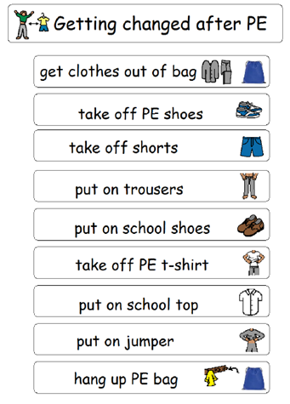
Visual supports
Notes:
Routines can be supported by step by step visual supports.
This one can be used to support verbal children to change for PE

Slide 19
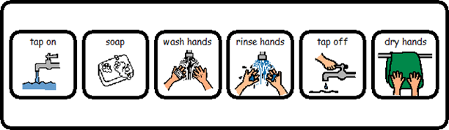
Visual supports
Notes:
And here is a simple hand washing sequence.

Slide 20
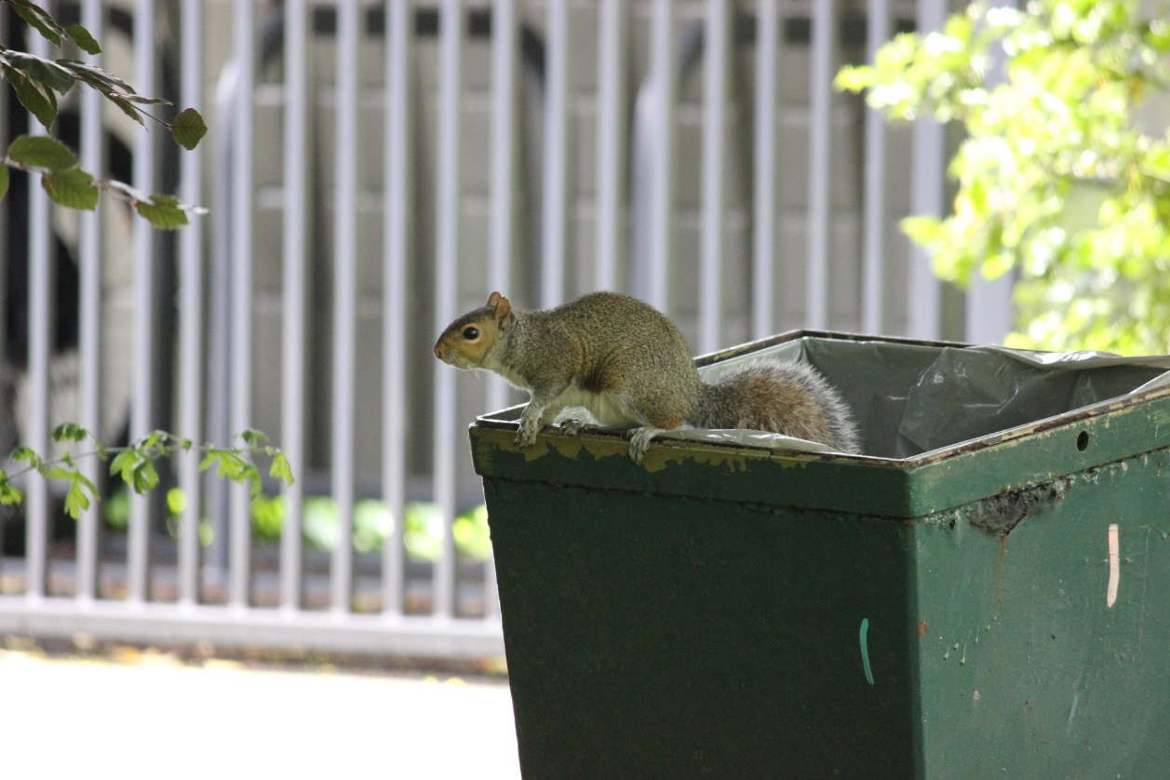
Weak central coherence
“Oh look! Someone’s throw away a perfectly good squirrel!”
(Griffin, 2009)
Notes:
Our Central Coherence skills enable us to use context to draw meaning; to see the big picture. In autism, focus tends to be on the detail rather than the whole.

Slide 21
What might we notice?
The child might:
Avoid making choices
Seem to understand everything you say
Seem to miss the point
Seem to focus on irrelevant details
Read fluently but…
Rote learn maths but as it becomes more complicated…
Notes:
Some learners may take a long time to make choices, or may even avoid choice making altogether. It’s easier to make a choice when you can imagine the implications of your decision, choosing (even something as simple as where to sit or which activity to join) when the implications are not clear to you can cause anxiety.
A child or young person might nod, say ‘Got it’ or give other signs that they have understood what you have said, but subsequent actions may suggest that they haven’t grasped the full meaning.
The information that an autistic learner may take from what you have said may be influenced by what is important to them at that point in time and may not be the information that you consider important.
Details, such as the colour of the aeroplane or the number of windows it has, may be more interesting to the learner than talking about the family boarding the plane, excited about their holiday.
Young children may seem to be able to read relatively complex texts but comprehension skills may be at a lower level.
Similarly, some Early Level learners may be quick to learn numbers and facts but when complexity increases and an activity requires several steps to a processes or more abstract problem solving skills, the pace of learning can change.

Slide 22
What mindset will help?
The adult might think:
Don’t take it personally
DIRM
Why? Why? Why?
Difference not deficit
How can I adapt my communication?
Environment first
Is the learning meaningful?
Notes:
Again we need to remember that it’s not personal, each child thinks differently and has different needs and we need to think about whether we can adapt our own communication, the physical and social environment or the opportunities being provided to make learning meaningful.
There are a range of thinking styles and perspectives in my class.
Some learners will notice detail, others will see a bigger picture.
I need to explain things in a way that accommodates both.
Accept that some learners might pick you up on small details; they are probably correct!
Understand that some of the unexpected questions that may be asked are important to the learner.
If a learner is refusing to participate or engage in something, it’s possible that it doesn’t make sense to them and they don’t know why they are being expected to do it. Rather than view this as non-compliance, focus on making it meaningful.

Slide 23
What can we do?
  Support choices
  Forced alternatives
  Visual prompts
  Identify the main idea in new information
  Identify key learning points
  Make links explicit
  Fore warn or changes and events
  Change one element at a time
  Rehearse
  Consider using Social Stories ™
Notes:
Choosing “from all the things in the world ever” can be overwhelming. Having a clear and limited range of options helps.
If these can be represented visually, all the better. Holding two pieces of fruit, or paint brush options where they can be seen by the child or young person as you ask them to choose can help them to decide between them. Use clear language, rather than, “Which do you want?, say, “apple or banana?”
When sharing information, explicitly state what are the key pieces of information you wish the children to focus on. And summarise at the end of the conversation, e.g. “So, trip on Friday, To the Zoo, bring a packed lunch.”
You might think you are making clear connections to prior learning or across subjects but it can be helpful to actually point these out. Yesterday we learned about Christianity, today we are learning about another religion, Buddhism.
The nature of life in schools is such that unexpected changes will occur. Staff will be absent, Assemblies will be postponed, rain will fall at break times and Dress Down Days will happen. Where possible, prepare the child or young person for changes, using visual supports to aid understanding.
Support learners by changing only one element at a time. In a new classroom, have familiar people and a familiar activity. Learn new skills first in a familiar and comfortable environment. Don’t change your seating plan and wall display on the same day!
Rehearsal can be helpful. Going to visit an empty hall before your first assembly or practice being an audience at the theatre. Not being first in the line for a circuit activity in gym can provide time to watch others to model the activity and time to process and plan the movements required.
Social Stories™ can be a useful tool to help prepare learners with good language skills for a new activity or environment, e.g. a school trip or residential.

Slide 24
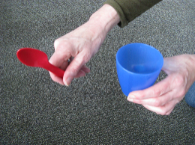
Supporting choices
Notes:
For children and young people at an early developmental level, choices can be supported by object signifiers, “Do you want something to eat or something to drink?”

Slide 25
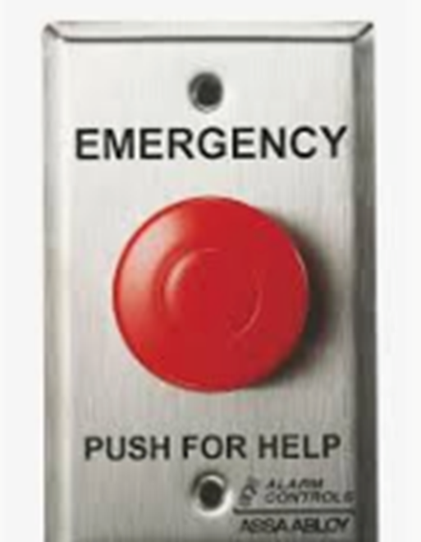
Context blindness
Notes:
We use context to make sense of the world around us. If you have difficulty looking at the big picture you may struggle to make sense of information in context.
If you were stuck with a maths problem…is this how you would get help?
If you saw this in an airport would you press it?

Slide 26
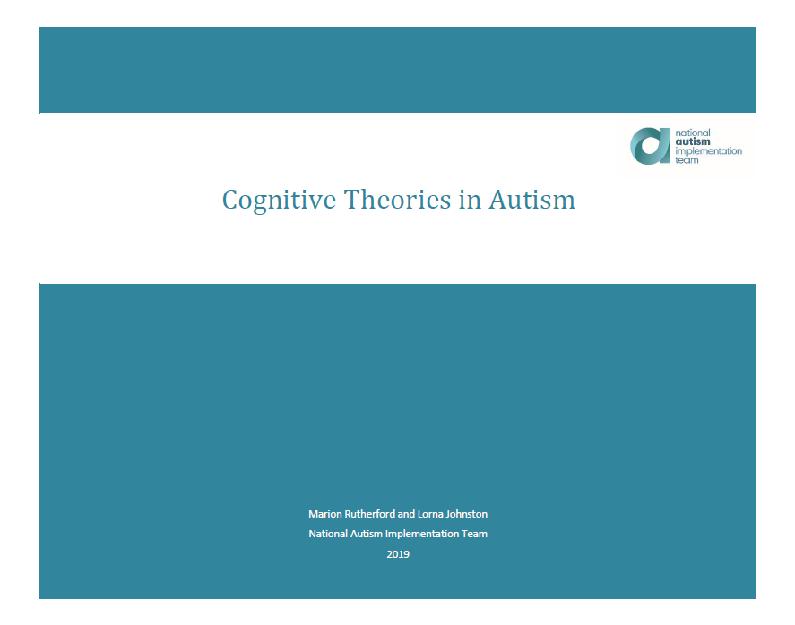
NAIT cognitive theories guide
Notes:
On the NAIT website there is a guide to the Cognitive Theories that we have referred to today, together with some ideas for further reading.

Slide 27

Collaborative groupwork
Notes:
Taking account of autistic cognition is important when we think about how we plan for some specific elements of the school day.
Groups can be more difficult than 1:1 interaction and therefore collaborative learning can present challenges.
When planning, you should be clear what your learning intention is for the child or young person in the lesson. An autistic learner may be able to focus on the learning or on the social interaction, but maybe not both at the same time.
When you decide it is appropriate to have a group learning context, reasonable adjustments may include:
Grouping with familiar and supportive peers
Allocation of clear roles
A focus on concrete tasks
a clear structure, sticking to familiar rather than new activities
and a
a predictable timescale
A range of visual supports can assist.

Slide 28
Supporting peer interactions
Secondary
Primary
Early Years
Notes:
Peer interaction is often harder than interaction with those older and younger. Adults are likely to make adaptations and younger children’s communication is likely to be less sophisticated and demanding.
Peer interactions change over time. It’s helpful to understand each individual child or young person’s current perspective on peer relationships.
Some children and young people may experience isolation or feel that they are not accepted, or even that they are rejected by their peers at times. Others may have strong social connections and a good friend or friends at school.
Some individuals are content in their own company and for them, peer relationships may not feel as important. They may not currently be seeking friends in school.
An autistic child or young person might not present what you might think of as typical peer interaction. It is important not to view this as a need to teach typical interaction skills.
Any support in this area should be tailored to the child or young person, acknowledging that individuals have different levels of motivation to have friendships with peers and that there are many ways a friendship can operate.
Social interactions are best supported in naturally occurring environments, e.g. through thoughtful pairing or grouping for tasks and activities or by providing lunch or after school clubs around shared interests, e.g. Lego, Debating or Star Wars.

Slide 29
Key messages
Environment first
Provide predictability
Make learning meaningful
Seek to understand distressed behaviour
Ensure adjustments are anticipatory
Difference, not deficit
‘We were expecting you!’
Notes:
Throughout the rest of this course we ask everyone to keep these Key Messages in mind. We’ve looked closely at three of them today. We will build on this in the remaining two Autism Units.

