Slide 1
Self-Evaluation of ITE Numeracy University of Strathclyde
June Pisaneschi
Jackie Marshall
08/10/19

Slide 2
SCDE Attainment Challenge Research Project EdD study (J Pisaneschi)
Rationale
Background in maths
Contexts & experiences in ITE and beyond – supporting meaningful learning?
Developing understanding of inclusive approaches
Do our teachings have a lasting impact?
Iterative longitudinal qualitative study over three years

Slide 3
Attainment Challenge Research Project: Building the profiles
In school, had very low confidence as a learner. “I’m not maths minded”.
Always in the lowest maths group. “ I didn’t have the brains”.
Sat Standard Grade Maths but made no attempt to engage with the questions – left an empty page.
Guidance teacher said “you’ll never be a teacher” because of your grades. “You’ll never go to uni”.
“I felt like I was thick and worthless”
“When I’m taking a maths lesson, I’ll need to be more prepared than others. () I don’t want the children to have the fears that I had of maths”.

Slide 4
BA4 Module – Developing Understanding of Inclusive Practice in Numeracy (Numeracy Clinic)
Module Leader – Professor Sue Ellis
How it works
Students work in teams of three or four. Each team has just one pupil. Each team member provides a one-to-one, tailored, 30-minute lesson at a regular time each week.
The pupil gets 3 or 4 lessons per week, on different days of the week - one from each team member.
Team members share their observations across the ‘3 Domains’, communicating to the group after each session - identifying progress and priorities for the next session.
The clinic principle is that people learn by “doing”. Students learn to make decisions based on the best available evidence and an emerging knowledge-base.

Slide 5
Where do we begin? Strathclyde 3 Domains Model (Professor Sue Ellis)
Cognitive knowledge, skills, previous learning
Personal/social
aspirations and identity
Cultural capital &
funds of knowledge – beliefs,
ideas, experiences, people,
activities, home numeracy

Slide 6
BA4 Developing Understanding of Inclusive Practice in Numeracy
Learning Opportunities & Benefits
Collaboration amongst peers; group discussion and problematizing children’s needs
Examining inclusive approaches for classroom teaching
Professional noticing & responsive teaching
Self-evaluation and reflection based on assessment of progress and peer feedback
Using academic reading to inform practice

Slide 7
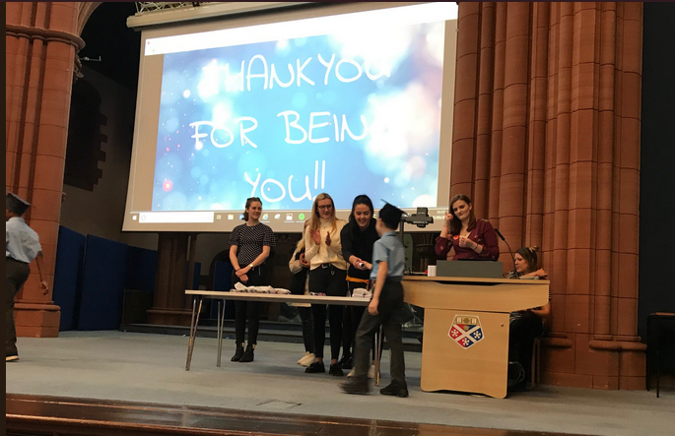
Celebrating Success with the Children

