Slide 1
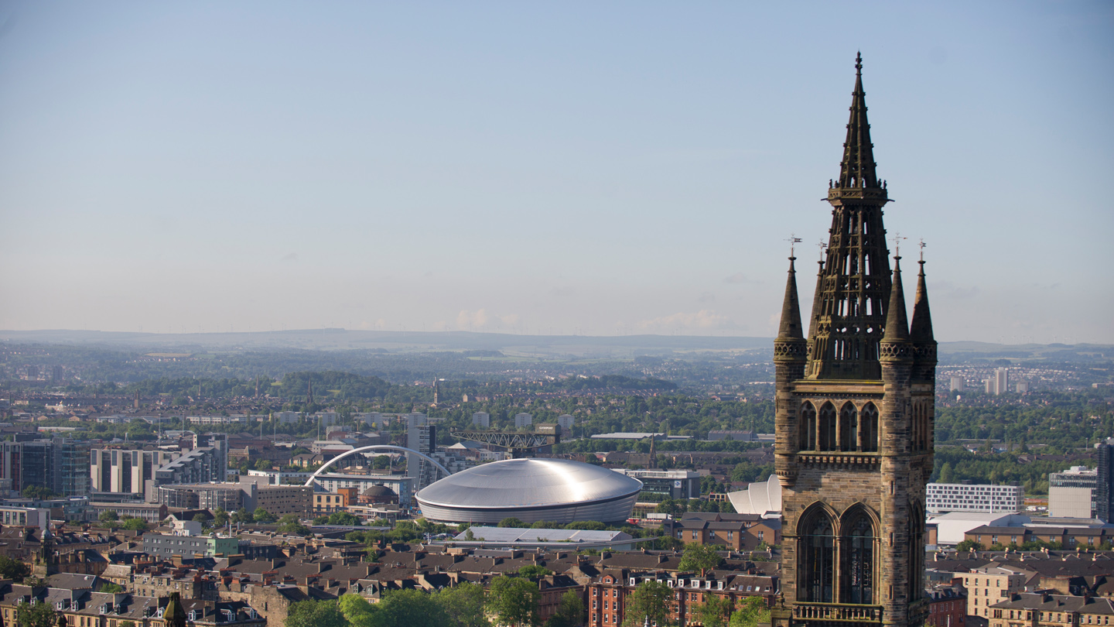
University of Glasgow School of Education - Mathematics
Enhancing Students’ Mathematical Experiences in ITE Programmes
Dr Ismail O. Zembat
Dr Cristina Mio

Slide 2
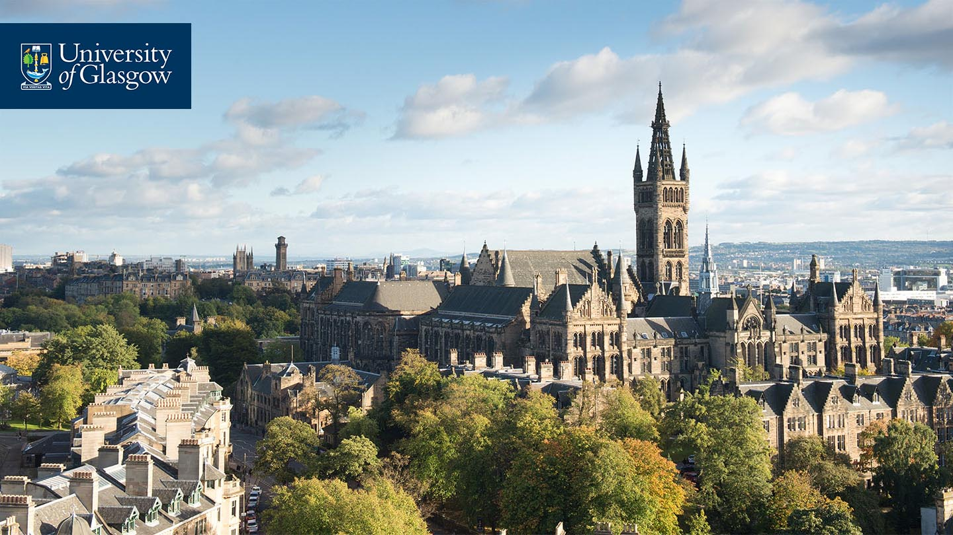
Overview of the Key ITE programmes at University of Glasgow in Mathematics Education
PGDE Primary
MEduc
PGDE Secondary

Slide 3
Evaluation of Mathematics Programmes...
1. What goals do we want to achieve?
2. What do we do to achieve these goals?
3. How do we monitor progress towards these goals?

Slide 4
Evaluation of Mathematics Programmes...
1. What goals do we want to achieve?
What do we do to achieve this?
How do we monitor progress towards these goals?

Slide 5
Our main goal in mathematics education programmes is to prepare:
Teachers as designers
through theory-driven experiences
Notes:
The Mathematics Education Programmes are designed in such a way that enables students to:
- be designers of learning environments
- perceive mathematics as a study of patterns/relationships/concepts, rather than a set of procedures to memorize
- have the ability to listen to pupils, interpret and anticipate their mathematical reasoning, track their learning trajectories
- have the necessary subject matter and pedagogical knowledge
- build confidence in putting principles in action and applying theory in practice
- continually reflect on their own practice and work toward improving it – having a dynamic view of planning, teaching, learning, assessment

Slide 6
Evaluation of Mathematics Programmes...
What do we want to achieve?
What do we do to achieve this?
How do we monitor progress towards these goals?

Slide 7
Our students experience
what it means to be designers through theory-driven practice

Slide 8
An example of referring to theory …
XMANIA NUMBER SYSTEM
A B C D XA
AA BA CA DA XB
AB BB CB DB XC
AC BC CC DC XD
AD BD CD DD XXA
AXA BXA CXA DXA XXB
. . . . .
B + C=?
D × XA = ?
How do people interpret brand-new information?
Notes:
Xmania makes the students experience the assimilation principle as part of learning theory. The students “live/experience” the theory through the activity.
Goal: to understand the importance of prior knowledge when learning new material.
Xmania Number System is a system used by a tribe in Amazons and it is not related to base-ten system. In other words, A in this system is not equal to 1, B is not 2, etc. The rules in Xmania system is not necessarily same as base-ten system.
The system starts with the number A. Every consecutive number is A units away from each other.
The numbers in the number system are sequenced as; A, B, C, D, XA, AA, BA, …, XB, AB, … , XC, …
XA is not supposed to be a two-digit number as in base-ten system, it can be a number like 7.

Slide 9
In terms of theory such an activity gives…
Students an opportunity to
Think about importance of prior knowledge
What it means to make sense of new knowledge
Experience “Assimilation” Principle of Piaget
So we do not teach directly about theory, but we help them understand theory through their reflection on certain activities they engage in (like Xmania)

Slide 10
Components a teacher needs as a designer…
Pupils’ reasoning and learning
Curriculum
Design​
Assessment
Subject knowledge
Classroom
norms
Use of
resources

Slide 11
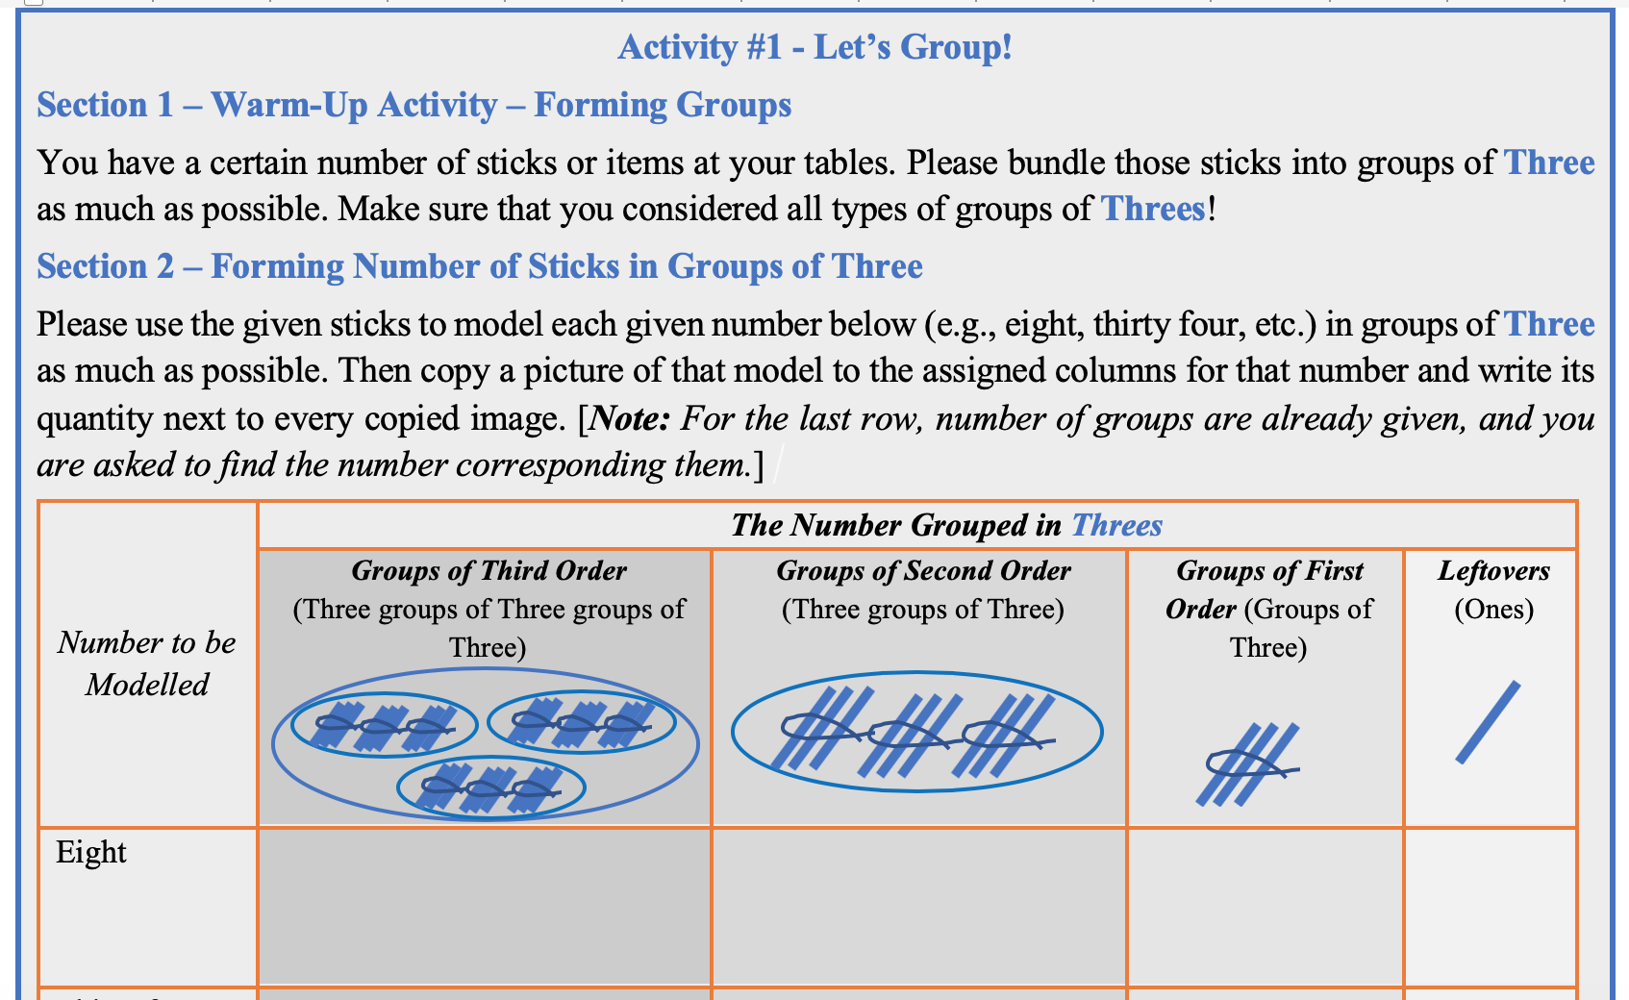
1. How do we foster curriculum design feature?
Curriculum
Design​
Pupils’ reasoning and learning
Assessment
Use of
resources
Subject knowledge
Classroom
norms
Grouping by 3, 5, 7, and 10 using sticks
Grouping by 4, 6, and 10 using interlocking cubes
Finding the number of cubes corresponding to “1202” in each type of grouping
Comparing different types of grouping regarding min/max and growth rate – identifying the advantage of working with 10
Notes:
Distribute copy of the lesson (20), sticks, and cubes to give the audience a feel for what it means to work in this environment.

Slide 12
Analyse the curriculum design…
Curriculum
Design​
Pupils’ reasoning and learning
Assessment
Use of
resources
Subject knowledge
Classroom
norms
A lesson design fostering an understanding of place value as a special type of grouping
Requires prior knowledge of
Representing numbers
Grouping given quantities
Focus pupil understanding on min/max number in each column and growth rate
Analysis of design principles
Notes:
We have them analyse the design principles for this curricular piece
- What is the purpose of each section?
- How each section contribute to pupil understanding?
- What difficulties would the design cause?
- …etc.

Slide 13
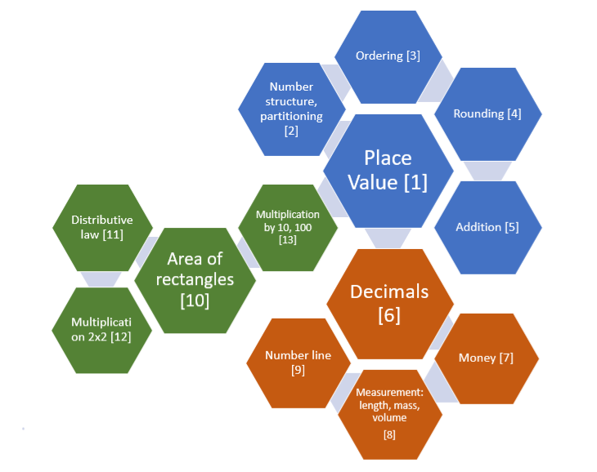
Analyse where it fits in overall map and CfE…
Curriculum
Design​
Pupils’ reasoning and learning
Assessment
Use of
resources
Subject knowledge
Classroom
norms
CfE E’s O’s | P0-P1 | P2-P4 | P5-P7 | S1-S3 | S4-S6
Number and number processes including addition, subtraction, multiplication, division and negative numbers | Use numbers to count, create sequences and describe order.[MNU 0-02a] Use practical materials to ‘count on and back’ for addition/subtraction [MNU 0-03a] | Understand construction of whole numbers, importance of zero, explain the link between a digit, its place and its value. [MNU 1-02a] Use +, -, x, ÷ to solve problems, use mental strategies [MNU 1-03a] | Extend the range of whole numbers, construction of decimal fractions, explain the link between a digit, its place and its value. [MNU 2-02a] Solve problems involving whole numbers using a range of methods [MNU 2-03a] Solve problems involving decimal fractions using a variety of methods. [MNU 2-03b] | Use a variety of methods to solve number problems, communicate processes and solutions.[MNU 3-03a] Recall number facts quickly and use them accurately in calculations.[MNU 3-03b] | Solve problems set in unfamiliar contexts.[MNU 4-03a]
Notes:
We also help students focus on issues like:
- What big concepts/ideas are targeted here?
- How do these concepts/ideas fit together?
- How do these concepts/ideas fit to CfE Experiences and Outcomes?
We focus on depth as well as breadth…

Slide 14
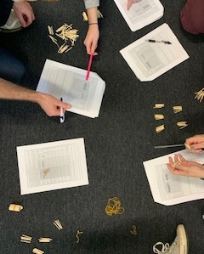
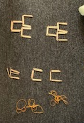
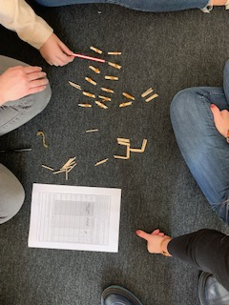
2. How do we foster an understanding of pupil’s learning?
This also gives them a chance to experience pupil lens…
Notes:
1. They initially go through these lesson plans as pupils with certain limitations
- They can only operate with a certain prior knowledge (representing numbers & grouping)
2. We don’t tell them that they will learn about place value to start with
3. With this prior knowledge they experience what it means to work on developing certain concepts like pupils, and their difficulties (just like in Xmania system)
4. Since they work in a different context (different bases than base-ten), they are not acting but experiencing what it means to be a pupil in a maths context

Slide 15
2. How do we foster an understanding of pupil’s learning?
Curriculum
Design​
Pupils’ reasoning and learning
Assessment
Use of
resources
In addition to going through a lesson plan, our students also wear teacher lens and analyse the learning mechanism of such lessons
They also analyse teaching videos of those lessons in terms of pupils’ developing understandings
Subject knowledge
Classroom
norms

Slide 16
2. How do we foster an understanding of pupil’s reasoning?
Curriculum
Design​
Pupils’ reasoning and learning
Assessment
Use of
resources
They focus on analysing pupil reasoning through video analyses
We choose research-based videos
The videos are about conceptual differences pupils have – we do not share any case:
A case of 47-39=…
A case of 70-23=…
Subject knowledge
Classroom
norms
Notes:
Show videos:
47-39
70-23 (only first part)

Slide 17
3. How do we enhance subject knowledge?
Curriculum
Design​
Pupils’ reasoning and learning
Assessment
Use of
resources
Subject knowledge
Classroom
norms
As they work on curriculum design, pupil reasoning and learning, they also enhance their content knowledge.
place value → a special type of grouping
triangle area → half the completed rectangle
quadrilaterals → a square is a special rectangle

Slide 18
3. How do we enhance subject knowledge?
Curriculum
Design​
Pupils’ reasoning and learning
Assessment
We help them develop subject knowledge that is specific to teaching of mathematics
Use of
resources
Subject knowledge
Classroom
norms
A teacher gives each group of students in his class a single unit like and asked each group how many of these units would fit on their desks. Then the teacher asked them to find the area of their desks.
A group of students made an arrangement as in Figure 1, found the result as 8×9=72 units, whereas another group of students used the units as in Figure 2 and found that 5×9=45 units would fit on the desk.
Figure 1 Figure 2
(Simon & Blume, 1994)
Explain why each group is right or wrong by giving the justification of your answer.

Slide 19
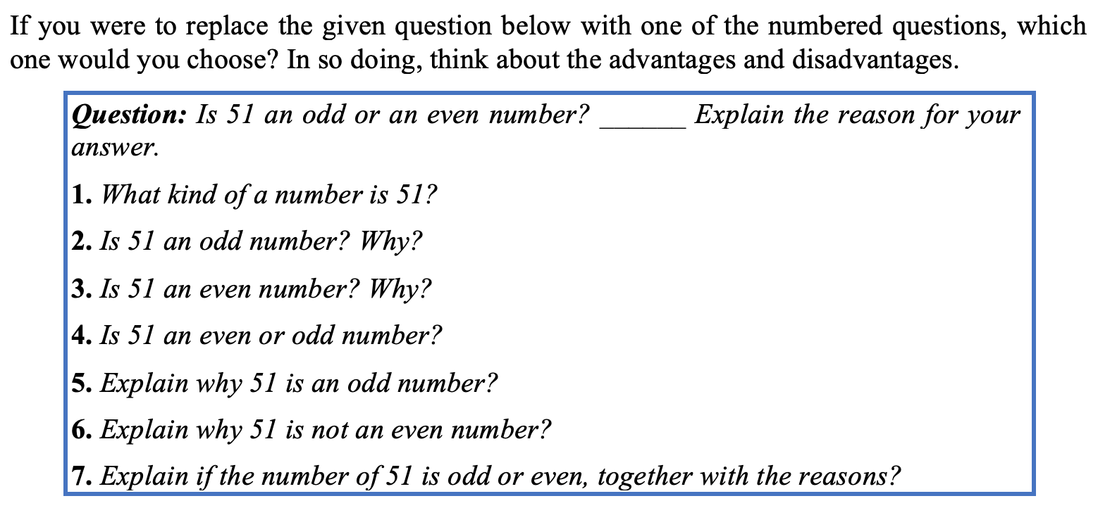
4. What do we do in terms of assessment?
Curriculum
Design​
Pupils’ reasoning and learning
Assessment
Use of
resources
Subject knowledge
Classroom
norms
Notes:
We focus their attention on different ways to think about assessment.

Slide 20
5- Social and sociomathematical norms
Curriculum
Design​
Social Norms | Sociomathematical Norms
Students question each other’s thinking. | Students ask each other questions that press for mathematical reasoning, justification, and understanding.
Students explain their ways of thinking. | Students explain their solutions using mathematical argumentation.
Students work together to solve problems. | Students reach consensus using mathematical reasoning and proof.
Students solve problems using a variety of approaches. | Students compare their strategies looking for mathematically important similarities and differences.
Students see making mistakes as a natural part of learning. | Students use mistakes as an opportunity to rethink their conceptions of mathematical ideas and examine contradictions. Mistakes support new learning about mathematics.
Pupils’ reasoning and learning
Assessment
Use of
resources
Subject knowledge
Classroom
norms
Notes:
… inside the lesson structure/plan and is brought out with the lesson analysis
Emphasised more with norms activity seminar

Slide 21
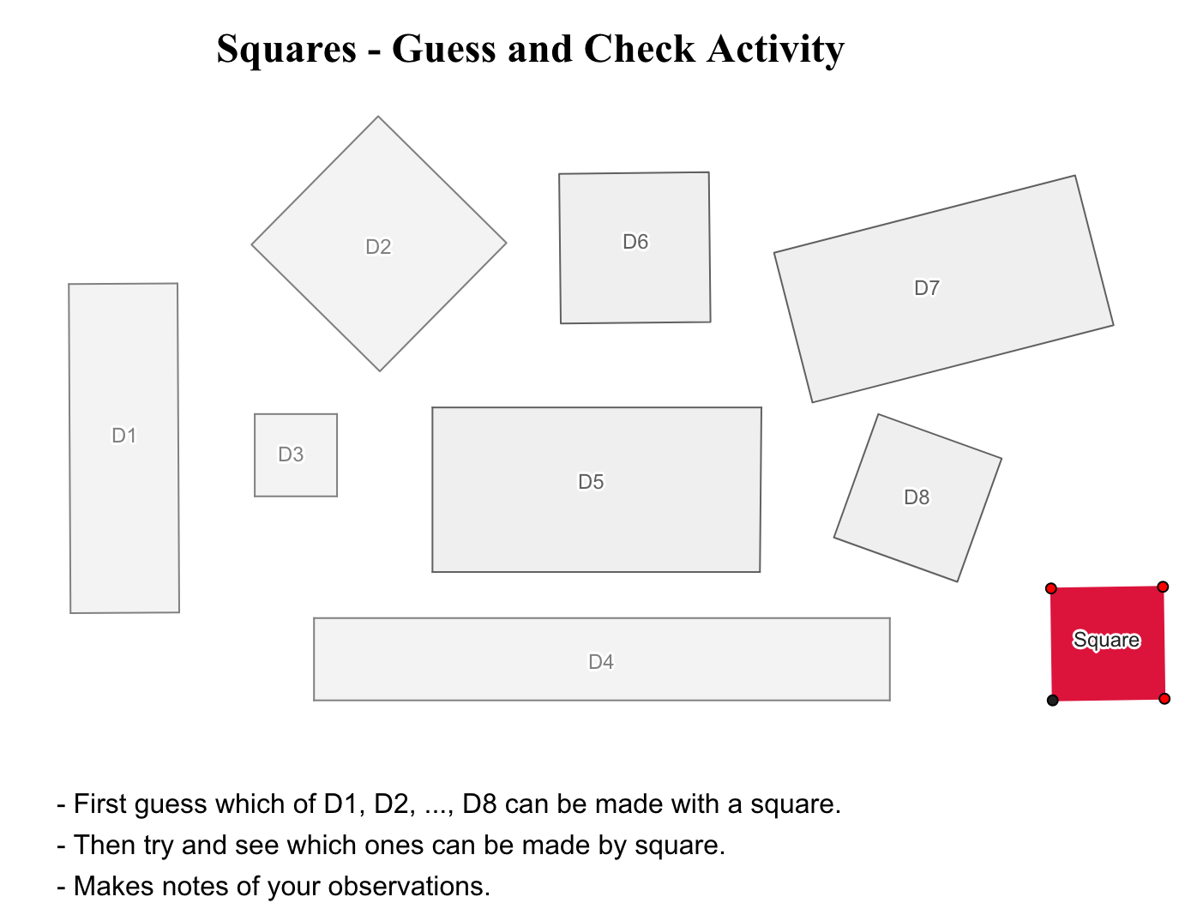
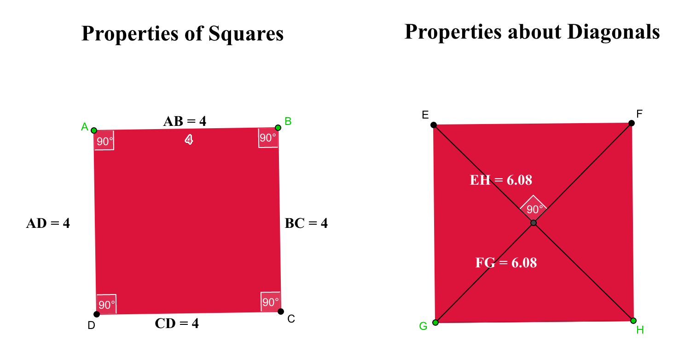
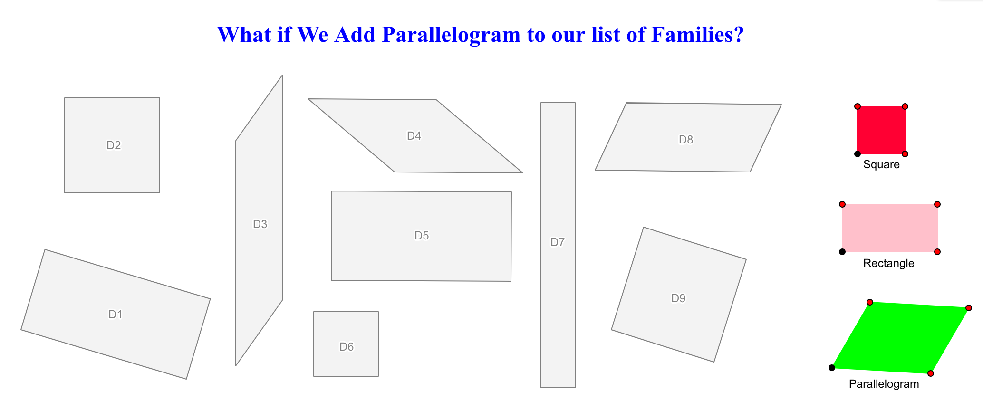
Curriculum
Design​
6- Use of Resources (Manipulatives, Technology, etc.)
Pupils’ reasoning and learning
Assessment
Use of
resources
Subject knowledge
Classroom
norms
The kind of activities we benefit from are:
Guess & Check for Square/Rectangle [operating with drawings but beginning to focus on properties]
Properties of Squares/Rectangles (side lengths, angles, diagonals, parallelism) individually
Thinking about relations between squares and rectangles based on constraints&flexibilities [operating with figures]
Comparing them to parallelograms […hierarchy]
Notes:
We integrate use of technology in our classes.
We teach our students how to use technology as a means to support pupils’ mathematical development.
Here is an example: (show Geogebra example for which the screenshots are shared here)

Slide 22
All of this is guided by our partnership with schools…
These lessons have been tested in real classrooms
They are currently being used in a Scottish Primary School (video)
Positive pupil/teacher feedback about our partnership
We share these experiences with our PGDE students
Notes:
To add: Show video from Primary School

Slide 23
Evaluation of Mathematics Programmes...
What do we want to achieve?
What do we do to achieve this?
How do we monitor progress towards these goals?

Slide 24
Community of Practice
We have a strong maths lecturer team with variety of schooling and academic experiences
We share our experiences in biweekly meetings and decide on further steps
Changes to the content of future seminars are made in a timely manner if any issues emerge
We consider student feedback seriously
This Photo by Unknown Author is licensed under CC BY-NC
Notes:
Maths team (5 members of staff – each with different expertise and perspective) meet every 2 weeks to talk about the seminars (new ideas, improvements, issues)
Everybody contributes

Slide 25
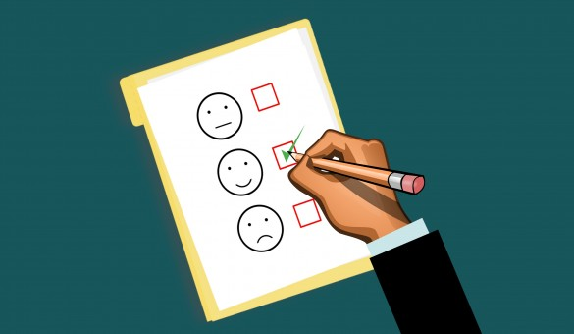
Speaking of student feedback …
This Photo by Unknown Author is licensed under CC BY-SA-NC
Ongoing dialogue and interaction with our students
Getting feedback at specific points throughout the year
Notes:
Her we can briefly talk about the anonymous survey we administered in our classes after first few weeks

Slide 26
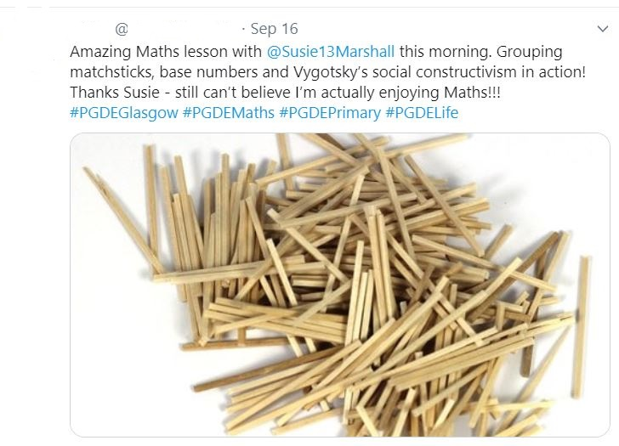
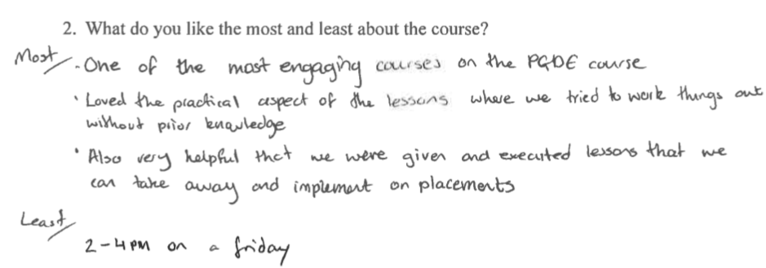
Speaking of student feedback…

Slide 27
Speaking of student feedback…
What do PGDE Primary students say?
Notes:
PGDE Primary Student video

Slide 28
Other measures to evaluate the Maths programmes
We use a feedback system called PTES for our PGDE Secondary Mathematics students
We also use a formal feedback system for every course (called EVASYS) that asks students about their experience in each course once the grades are revealed
Notes:
If they ask “How do you know what the student teachers will do in school…”, then we say that we follow the partnership model, and that we have a L&T assignment where the students have to select, develop and implement relevant content, resources, learning activities and teaching approaches for this topic.
The student have to evaluate their teaching of that topic with respect to pupil learning and reflect on any changes to the teaching or content that they would make as a result of this evaluation.
When we assess this assignment, we can gauge the level of understanding (in terms of how to teach and reflect) of our student teachers.

Slide 29
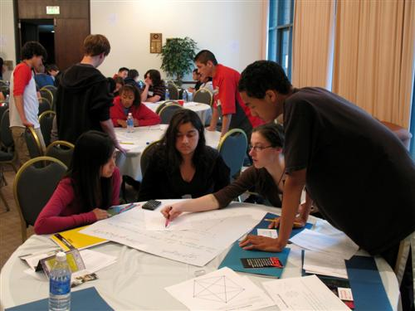
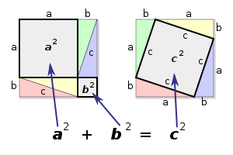
What do we do at the Secondary Mathematics Level?
This Photo by Unknown Author is licensed under CC BY-SA-NC
Notes:
So far we have shared the experiences given for primary Mathematics.
The same themes run through the PGDE Secondary, but with a different style.

Slide 30
What do we do at the Secondary Mathematics Level?
Building a knowledge base through active participation by focusing on:
Developing a different mindset for Maths and its beauty and learning
Teaching Mathematics for Understanding
Tasks on lesson development through exchanging ideas in group
Benefitting from Neuroscience/Psychology with respect to Maths learning
Socio-cultural aspects of constructing mathematical knowledge (norms)
Assessment for Learning and questioning

Slide 31
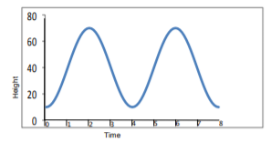
What do we do at the Secondary Mathematics Level?
Experiencing hands-on lessons (e.g., Ferris wheel lesson for trigonometric functions)
STEM applications (collaboration with PGDE Secondary Science students)
Notes:
Hands on = teaching for understanding
STEM …. – example of different mindset - Maths
Maths and Science - what are the common big ideas? Eg proportional reasoning, units, interpretation of graphs

Slide 32
What feedback do we get from our Secondary PGDE students?
Video 1
Video 2
Video 3
Notes:
We will show part of one of these videos as long as the time permits.

Slide 33
Challenges & Priorities
Students need to be convinced - different from how they were taught/different mindset
Different mindsets in primary and secondary PGDE students:
Primary - feel insecure since they are not confident in their mathematics knowledge
Secondary - know mathematics but are disconnected from school mathematics

Slide 34
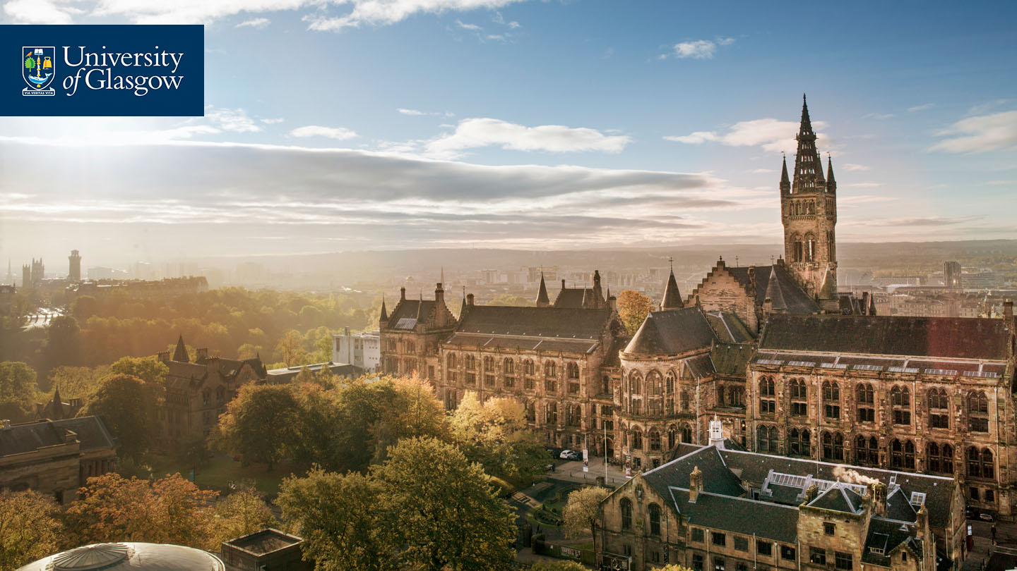
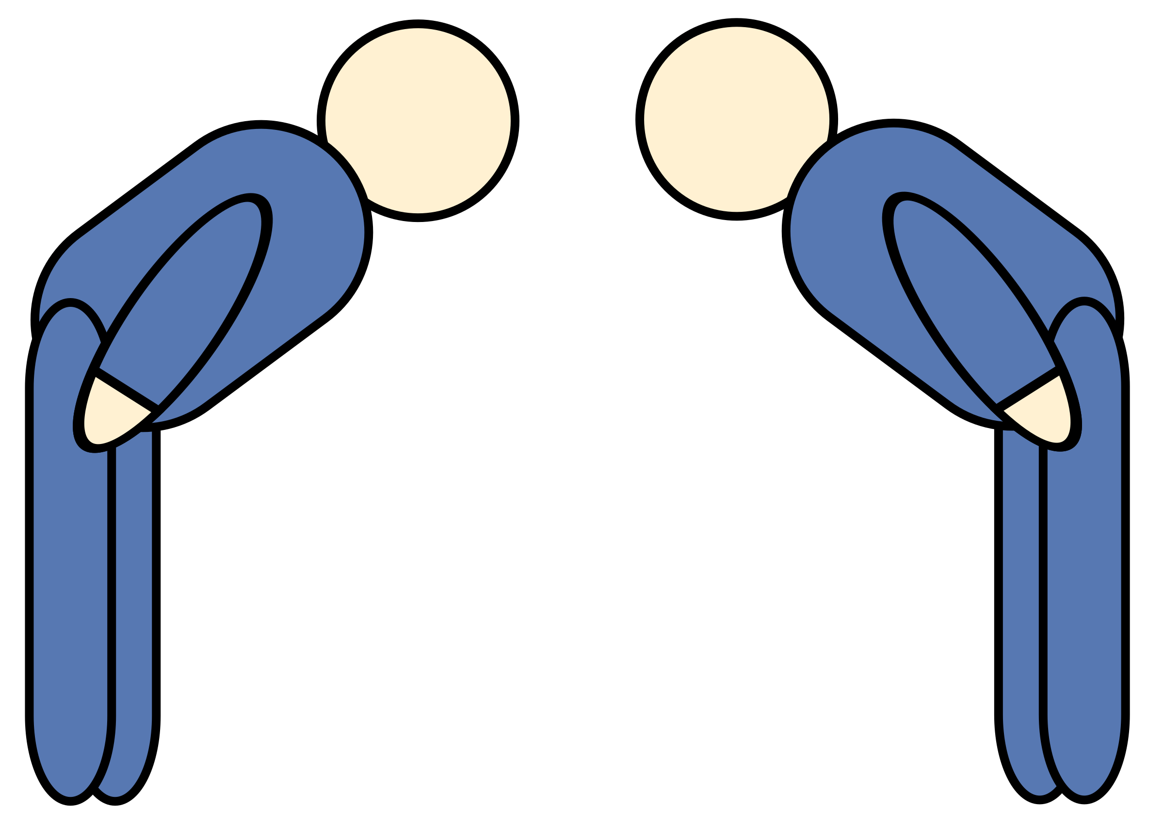
Thanks… Any Questions? Ismail.Zembat@Glasgow.ac.uk Cristina.Mio@Glasgow.ac.uk

