Slide 1

Autism Unit 3
Autism and Anxiety
Initial Teacher Education Autism Course Content
Notes:
(Presenter note: You will need an unopened coke can for this presentation. See notes on slide 9.)

Slide 2
Authorship
This unit belongs to a suite of resources developed by a Scottish Government working group including representation from:
Learning Directorate, Scottish Government
National Autism Implementation Team
Education Scotland
University of Strathclyde
General Teaching Council for Scotland
COSLA
ADES
Autistic individuals
Scottish Autism
National Autistic Society
Scottish Council of University Deans
These slides should not be reproduced or used without permission.
Notes:
(Presenter note: No need to read out. Will be included as part of PPT if shared electronically.)

Slide 3
Plan
Key Messages
Anxiety
The Losing it Line
The 24 hour child
Key Messages
Notes:
(Presenter note: Read only – do not expand at this point)
The plan for today is:
Key Messages
Anxiety
The Losing it Line
The 24 hour child
Key Messages

Slide 4
Key messages
Environment first
Provide predictability
Make learning meaningful
Seek to understand distressed behaviour
Ensure adjustments are anticipatory
Difference, not deficit
‘We were expecting you!’
Notes:
All four units of the Autism course content will be focussing on these seven Key Messages.
We introduced them as we set the scene with Autism Unit 1 with:
Ensure adjustments are anticipatory
‘We were expecting you’
Environment first
In Unit 2 we looked at:
Environment first
Provide predictability
Make learning meaningful
Today, in Unit 3, we will focus on:
Seek to understand distressed behaviour
And
Ensure adjustments are anticipatory
As before, this presentation will highlight each as we go through, with the symbol in the top right corner.
We hope that this autism course content is just the start of your autism learning - that you will leave enthused to keep reading and learning.
Throughout this course we ask that everyone keep these Key Messages in mind. If you only take seven messages from the autism course content, let it be these…

Slide 5
Why might an autistic child be anxious?
  Working memory
  Concept of time
  Imagining what might happen next
  Understanding perspectives of others
  Comprehension
  Fear of sensory responses
  Focus on detail
  Feel they always get it wrong
Notes:
Why would an autistic child be anxious?
Why wouldn’t they be?
If you don’t know how long something is going to last…
Are unsure about what is going to happen next…
Are unclear about the expectations of those around you…
Haven’t fully understood what you are supposed to do…
Are fearing sensory reactions…
…and feel that you never seem to get it right!

Slide 6
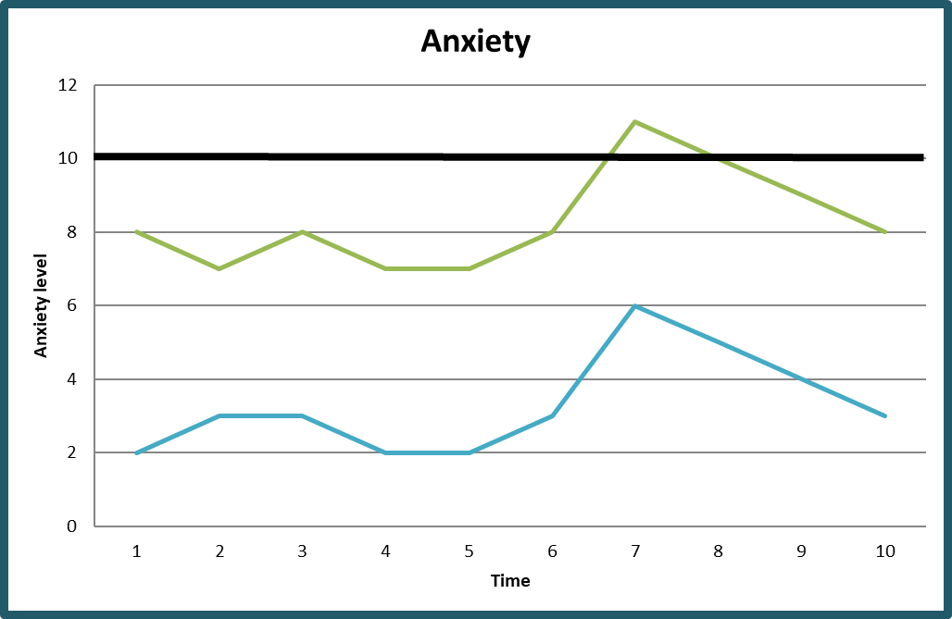
Understand distressed behaviour
The losing it line
Notes:
Often we are asked ideas for dealing with behaviours or meltdowns when young people have anxiety at a very high level. Whilst we would always advocate providing the right support to avoid getting to this point, we might not always get this right.
Within the resource we use ‘The Losing it Line’ as a tool to help people to understand that the reactions they see are unlikely to be explained by the last thing that happened. In actual fact, a wide range of factors in a young person’s environment and routines are likely to have contributed.
We are going to talk you through a scenario using the tool.
We start with a graph. The Y axis up the side marks level of anxiety and the X axis along the bottom is the passage of time. Each point on the coloured lines represent a different event in the day.
The blue line along the lower part of the graph represents most neurotypical people on an average day, with nothing big or significant going on in their life to cause major distress.
They might get up on the morning worried about the day ahead
***click***
but calm themself down by thinking calmly about the day over a cup of tea.
***click***
They set off for work and there is a diversion on the road. They start to get anxious about being late and take a detour
***click***
Lots of others have taken the same route and now they are stuck in traffic and are very late.
***click***
Suddenly the car behind bangs in to theirs!
***click***
No one is hurt but it will take the rest of the day for them to return to the level they were at the beginning of the day.
***click***

Slide 7
Understand distressed behaviour
The losing it line
Losing it line
Notes:
For a range of reasons, autistic children are likely to start their day at the higher level – the green line.
They may waken up anxious but their parent calms them down by looking at their home visual timetable for the day.
***click***
There is none of their favourite cereal left
***click***
but they find an alternative they like.
***click***
They set off to school later than usual so someone else got to the front of the line first.
***click***
Someone else got the coat peg they had wanted.
***click***
Someone brushed past them and brushed them softly on the arm.
***click***
That’s it, they’ve lost it, they are on the ground kicking and screaming. They are ‘over the losing it line!’
The adults are all saying, “There was no reason at all for that! It’s come from nowhere.” But it hasn’t.
We can’t take away all the sources of anxiety for the child or young person but we can try to reduce them. The NAIT Key Messages are all designed to do this. One of the simplest ways to do this is to make the child or young person’s day predictable.

Slide 8
When over the line
use very little language, if any
give time and space to recover
think back to what might have caused the reaction
think about what you can do to prevent it happening again in the future
Notes:
When a child has gone over the losing it line:
Walk away – observe from a safe distance
Stop talking
Wait – it may take longer than you imagine
The adults should reflect later (we don’t recommend ‘post match analysis’ with the child)
Think about prevention – What could be done differently to avoid the same circumstances leading to a similar response in future?
The book ‘Uniquely Human’ by Barry Prizant provides an interesting approach to thinking about behaviour

Slide 9
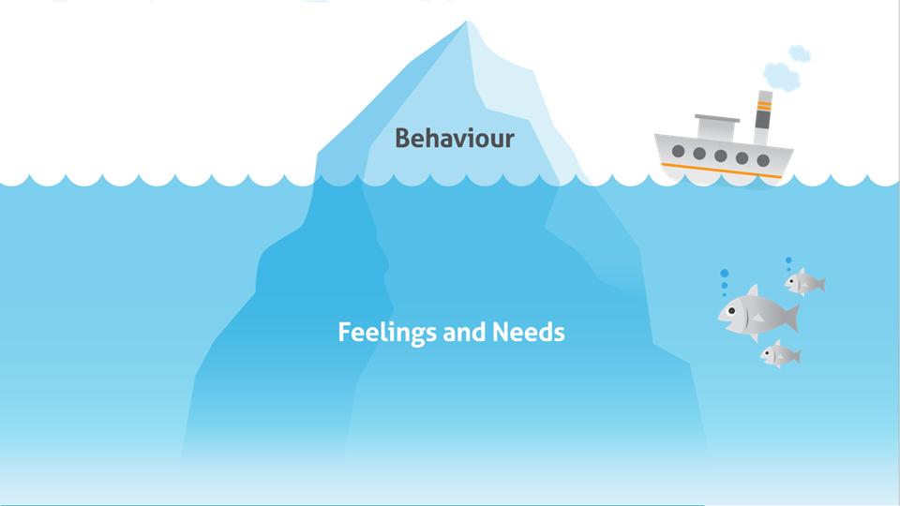

motivation
understanding
attention
tiredness
Autism Lens
time perception
memory
coping with change
communication
sensory
Notes:
You may already be familiar with the iceberg analogy for behaviour – the tip is the part you see but the biggest part of the iceberg is what lies beneath the surface.
Generally we look below the surface to consider the possible underlying reasons for behaviours.
With autism you have to use an autism lens to look deeper…
Is the child struggling with working memory, having difficulty understanding how long something will last, finding the transition difficult, trying to cope with sensory responses, having difficulty understanding what is expected and how to ask for help?
It’s important to think ‘Why? Why? Why?’

Slide 10
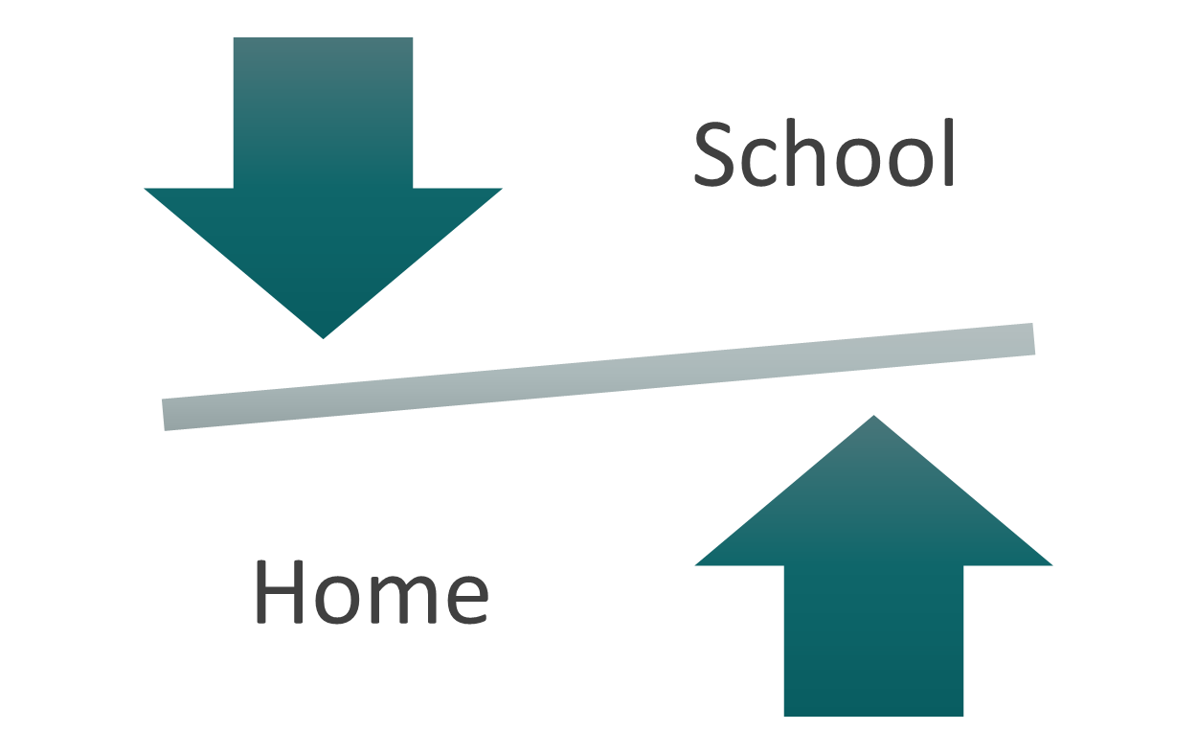
The 24 hour child
Notes:
(Presenter note: Use a Coke can to demonstrate. Start by holding this up.)
For this next part you have to suspend your disbelief and imagine that this Coke can is an autistic child.
Mum or dad take me to school in the morning (shake can)
Someone else is first in the playground (shake can)
Someone else is first in line (shake can)
Someone is sitting on the bit of carpet that I had wanted to sit on (shake can)
The day usually starts with Literacy but Mrs Bell says that this morning there’s a special assembly (shake can)
Mrs Bell seems a bit different today – I think she has a different smell (shake can)
After break we usually have art, but we missed Literacy this morning so we have to do that now (shake can)
I’m looking forward to pizza at lunch time but when I get there it’s all finished and I have to have fish (shake can)
Mum comes to get the child at the end of the day and the child LOOKS EXACTLY THE SAME
Teacher says, “There’s been lot’s of change today, BUT “HE’S NOT BOTHERED BY CHANGE!”
The child goes home, takes their jacket off and… (PRETEND to open the can over someone at the front of the audience)
It’s a familiar story, often reported in autism. Children ‘hold it together’ all day and the reaction can appear at a later time and at a different context.
If you hear of a stark difference between a child’s presentation at home and at school, don’t assume the problem is at home - “We’re doing ok, they must be doing it wrong at home!”
It is likely that if you increase the predictability and desirability for the child at school, life at home may significantly improve. This can work both ways round.

Slide 11

But what about the behaviour?
Notes:
Sometimes, at the end of a presentation on autism, we are asked, “But what about the behaviour? What do we do about that?”
Once a child is at a point of displaying distressed behaviour, all we can really do is wait for them to recover and then afterwards take the time to reflect as a staff team:
What can we do or change to prevent the child feeling the need to repond that way in future?

Slide 12
Key messages
Environment first
Provide predictability
Make learning meaningful
Seek to understand distressed behaviour
Ensure adjustments are anticipatory
Difference, not deficit
‘We were expecting you!’
Notes:
Throughout the rest of this course we ask everyone to keep these Key Messages in mind. We’ve looked closely at Seek to understand distressed behaviour and Ensure adjustments are anticipatory today. We will build on this in the remaining Autism Unit.

