Slide 1
Scottish Council of Deans of Education Royal Conservatoire of Scotland, Glasgow 19 May 2017 The role and contribution of higher education in contemporary teacher education Ian Menter Emeritus Professor of Teacher Education, University of Oxford

Slide 2
Background
To examine the role and contribution of higher education in contemporary teacher education. The paper will draw on international practices and research and will relate the analysis of these insights to the current Scottish context and to the developments that have occurred since the publication of Teaching Scotland's Future ('The Donaldson Report').

Slide 3
Overview
Introduction
International overview
Historical perspectives
Philosophical perspectives
Policy perspectives
Conclusion (1)
The Scottish context
Historical perspectives
Recent policy
Looking ahead
Conclusion (2)

Slide 4
Introduction
To insist on the importance of universities' involvement in the preparation of teachers is neither to insist on the status quo nor to diminish the importance of schools in the process. Clearly that involvement is properly fundamental and extensive, and the recognition that schoolteachers and university tutors meet on this ground as equals, with different and complementary forms of understanding and expertise, is the basis for honest and successful cooperation and partnership.
Furlong and Smith 1996:3

Slide 5
Introduction

Slide 6
Introduction
The effective teacher
The reflective teacher
The enquiring teacher
The transformative teacher
Menter et al, 2010
[Teachers]... as reflective, accomplished and enquiring professionals who have the capacity to engage fully with the complexities of education and to be key actors in shaping and leading educational change.
Donaldson, 2011:4

Slide 7
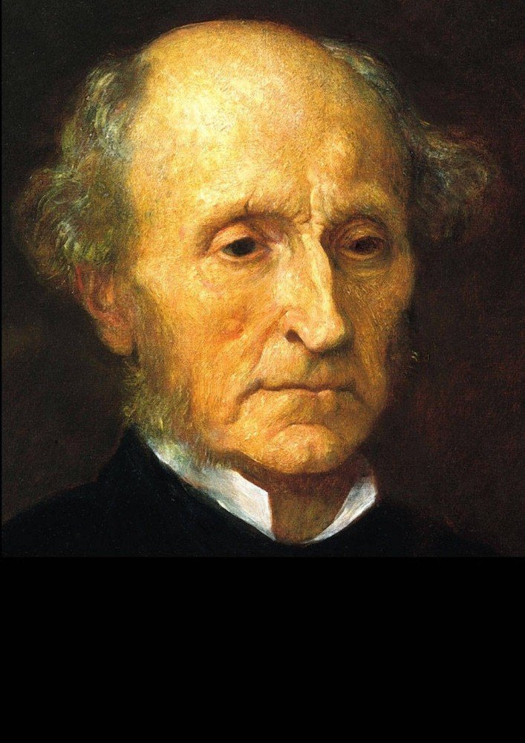

Slide 8
An international overview – historical perspectives
There is a tolerably general agreement about what a university is not. It is not a place of professional education. Universities are not intended to teach the knowledge required to fit men (sic) for some special mode of gaining their livelihood. Their objective is not to make skilful lawyers, or physicians or engineers, but capable and cultivated human beings.
J.S.Mill, 1867, St Andrews, cited by Pring, 1996: 15

Slide 9
However….
Davie – The Democratic Intellect
Collini and Nixon – the humanising element of a university education
In teacher education: ‘universitisation’ and partnership

Slide 10
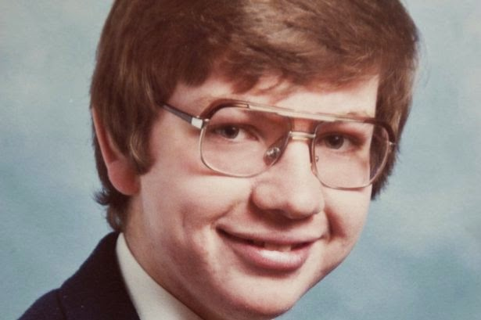
But…
The trouble with ed schools (Labaree)
‘Barmy theory’ and ‘the blob’ (Clarke and Gove)
The 'fragile, even febrile, position of teacher education within the university' (Moon, 2016)

Slide 11
Moon (2016): 'Do universities have a role in the education and training of teachers?'
orientation towards the practical;
research-focused pre-service training;
responsibilities around disadvantage in schools;
active involvement in professional development;
and, alternative routes into teaching.

Slide 12
Two further elements
Europe
Bologna process, Master’s level
but now Brexit
(Murray, 2016)
Research and teaching
(BERA-RSA 2014)
SCRE
Stenhouse
Goldacre
Evidence-based teaching

Slide 13
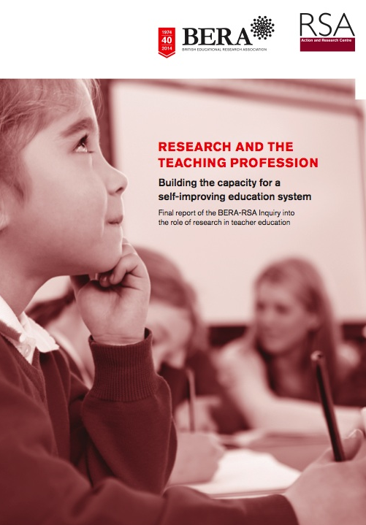
Final Report May 2014
Research and the Teaching Profession
Building the capacity for a self-improving education system
The importance of research literacy as an entitlement
Clinical practice
England as an outlier in the UK
www.bera.ac.uk

Slide 15
Philosophical perspectives
Winch, Orchard and Oancea (2014): 'three interconnected and complementary aspects of teachers' professional knowledge: practical wisdom, technical knowledge and critical reflection'.
'the type of deeper insight and understanding that comes from interrogating one's practice based on the wider research evidence and making explicit the assumptions and values that underpin it’.
Burn and Mutton (2014): 'research-informed clinical practice[s]’ which 'seek to integrate practical engagement in schools with research-based knowledge in carefully planned and sequenced ways‘
such approaches ‘do have the potential to make a positive effect on beginning teachers' learning and confidence, but that much depends on the quality of the clinical experience.’

Slide 16
‘Practical theorising’
'both looking for attractive ideas for practice and subjecting these ideas to critical examination' (Hagger and McIntyre, 2006:58).
Beginning teachers are only likely to be able to answer the more challenging questions 'as a result not only of quite extensive experience and very careful consideration but also through debate with experienced colleagues and through reference to relevant research and scholarship' (ibid, 59).

Slide 17
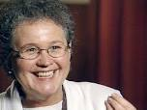
Insights from research
England:
Furlong et al (2000)
Complementary and collaborative partnerships
USA:
'strong relationships, common knowledge, and shared beliefs among school- and university-based faculty jointly engaged in transforming teaching, schooling, and teacher education'
(Darling-Hammond, 2012: 138-9).

Slide 18
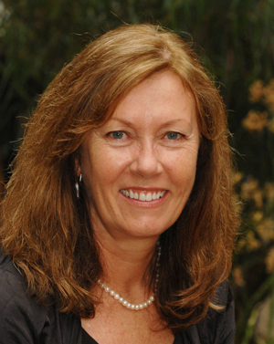
Australia
SETE findings and analyses suggest that preparing, supporting and retaining high quality early career teachers requires a reconsideration of teacher education across the real and/or perceived divides created by the dichotomies embedded in policy talk globally. It explicitly supports notions that schooling and educating teachers be viewed as a collective responsibility between universities, schools, systems and communities within a newly created real or imagined third space. (Mayer et al, 2015:20)

Slide 19
Policy perspectives
Tatto: Finland, Singapore, the USA and Chile, representing the range from 'excellent' to 'fair' according to the OECD categories.
what is notable 'about provision in both Finland and Singapore, as compared to the more diverse, fragmented and market-oriented provision in the USA and Chile, is the extent to which teachers' engagement with research and enquiry-oriented practice is embedded throughout the education system'
BERA-RSA, 2014: 15
Australia
TEMAG: Action Now - Classroom Ready Teachers - identified some weaknesses in provision including 'insufficient integration of teacher education providers with schools and systems'. One of their main recommendations is that 'theory and practice in initial teacher education must be inseparable and mutually reinforced in all program components'
TEMAG, 2014:xiii

Slide 20
Australia
Action Now:
Classroom Ready Teachers

Slide 21
The Teacher Education Group
Five nations: the power of home international study
England as an outlier
Reports, reports, reports
Relationships between research, policy and practice
Teacher Education Group (2016) Teacher Education in Times of Change. Bristol: Policy Press

Slide 22
…England…
Teaching is a craft and it is best learnt as an apprentice observing a master craftsman or woman. Watching others, and being rigorously observed yourself as you develop, is the best route to acquiring mastery in the classroom.
Gove, 2010
We are left in little doubt that partnership between schools and universities is likely to provide the highest quality initial teacher education, the content of which will involve significant school experience but include theoretical and research elements as well.
House of Commons Education Committee, 2012:3

Slide 23
Conclusion (1a)
The role of universities in ITE:
the analysis of the subject matter to be taught is related to the mode of understanding of those who are to learn;
there is a need for centres of expertise which can be put to the service of schools;
the training of teachers must take place against a background of relevant and systematic research;
the development in ...schools of the intellectual and research-based framework within which there can be the exploration and testing of ideas essential to professional preparation require[s] support from those who exemplify such activities;
the training of teachers must take place within the context of a critical tradition.
Pring, 1996:19-20

Slide 24
Conclusion (1b)
But also:
vi. we need models of ITE which enable beginning teachers to experience the theorising of practice - this entails fully integrated models of teacher education, which may well have clinical elements;
vii. from the outset, provision needs to be planned in partnership jointly by staff in universities and schools;
viii. the partnership provision should extend beyond ITE, to include shared approaches to continuing professional development and educational research, thus creating an extended professional community of practice and enquiry.

Slide 26
Furlong (2013)
'the maximisation of reason':
It is this principle.... that is still at the heart of the idea of the university; it is this principle that can and should be applied to all of our research and to all forms of teaching, be they general or, as is more often the case in education, vocational.
Furlong, 2013:181

Slide 27
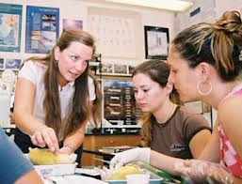
The Oxford Education Deanery
The Education Deanery is a knowledge exchange framework within which university–school partnerships in Research, Continuing Professional Development and Initial Teacher Education can be formed and sustained.
Seeing teacher development and learning as a career-long continuum, taking place within an established professional community of practice and enquiry.
Drawing on the wider resources of the University and other partners.
Aiming to support learning of children in schools, with a particular focus on the most disadvantaged

Slide 28
The Scottish context: history
Chairs in education from 1876
Colleges of Education
Universitisation – ambivalence
The democratic intellect
Education as a key pillar of civic culture
The role of GTCS
The problem of partnership

Slide 29
Recent policy developments
Sutherland Report 1997
Two stage review of ITE 2000 (post-McCrone)
First stage consultancy report
Second stage committee recommendations
2009 Graham Donaldson commissioned (Also Curriculum for Excellence and McCormac)

Slide 31
Donaldson
‘The values and intellectual challenges which underpin academic study should extend their own scholarship and take them beyond any inclination, however understandable, to want narrow training of immediate and direct relevance to life in the classroom.’
Donaldson, 2011:6
‘Scotland's universities are central to building the kind of twenty-first century profession which this Report believes to be necessary.’
Donaldson, 2011:104

Slide 32
In the meantime…
Scottish Teachers for a New Era
Glasgow West clinical teacher education model
Responses to Donaldson
Deputy First Minister’s call and proposals from providers

Slide 33
Looking ahead – Conclusion (2)
The evidence reviewed in this paper demonstrates very clearly that simplistic apprenticeship models for the preparation of teachers are very poorly suited to developing creative, critical and reflective professionals of the kind that Graham Donaldson was calling for.
…through the involvement of the universities as a fundamental element of provision, we may continue to see innovation and improvement that will ensure that the teaching profession itself continues to be held in high esteem and that the continuing challenges of overcoming educational disadvantage are directly tackled by teachers and teacher educators who understand these challenges and are equipped with the skills to address them.

Slide 34
Three themes for discussion
1. Partnership and clinical practice –
what needs to be done to create a genuine community of practice and inquiry across the schools and universities? What is meant by 'integrated', 'complementary', 'collaborative', etc?
2. The changing nature of teaching in the 21st century –
what are the key determinants of how teaching is being redefined? Technology, school governance and structures, globalisation? What changes in curriculum, in assessment, in pedagogy are we anticipating and what might the implications be for teacher education?
3. The distinctiveness of Scottish teacher education –
what might be identified as distinctive in our context and what is worth fighting for?

Slide 35
ian.menter@education.ox.ac.uk

