Slide 1
Initial Teacher Training Autism Toolbox Overview

Slide 2
www.autismtoolbox.co.uk
Notes:
Developed by the Autism Toolbox Working Group, this toolkit is closely linked to Curriculum for Excellence and the Scottish educational context. The Autism Toolbox is funded by the Scottish Government and managed by Education Scotland. The Autism Working Group is led by Education Scotland Inclusion Wellbeing and Equality Team supported by the Scottish Government.
The Toolbox working group is a collaborative partnership which has representation from:
Autism specialist practitioners
Educational Psychologists
Local Authority Education officers
NAIT – National Autism Implementation Team
NHS – Allied Health Professionals
NHS – CAMHs
NHS Education
Parents of autistic children and young people
Scottish Autism
Teachers
Universities
The working group value the contributions from autistic individuals to the development and ongoing work of the refreshed Autism Toolbox. Contact the working group at autismtoolbox@gov.scot

Slide 3
Aim of the Autism Toolbox:
To help staff support autistic learners and their families
within the framework of Curriculum for Excellence and
the Getting it right for every child approach.
Notes:
Funded by the Scottish Government through the Scottish Strategy for Autism
Managed by Education Scotland
Developed by the Autism Toolbox Working Group- including education, health and third sector representatives.
Designed for all educational practitioners
Redesigned, Refreshed and re-launched in November 2019

Slide 4
The National Model for Professional Learning highlights that professional learning and development can take many forms.
The Autism Toolbox and Professional Learning
The Autism Toolbox can support:
Professional reflection/evaluation
Professional development
GTCS Professional Update and Professional Recognition
Initial Teacher Education
Advanced study in Autism and Inclusive Practice
Notes:
The Toolbox is Highlighting it to you know as part of your time in ITE, however anticipating that it will be resources you will return to frequently at various times throughout your career as a teacher.

Slide 5
The Autism Toolbox provides:
Up to date information, set within the Scottish educational, health and social context of Autism and inclusive practice.
Free information, guidance, resources and professional learning opportunities for educational practitioners, schools and local authorities on Autism and inclusive practice.
An overview of the Autism identification and support pathway.
Notes:
Key people identified to update the toolbox as required
Includes resources- this section is not complete with further resources to be added. It is anticipated that resources will continue to be added so this section will continue to grow and develop over time.

Slide 6
Autism Toolbox Structure
Understanding Autism
Welcome
Scottish Context
Assessing and Monitoring
Supporting Learners and Families
Wellbeing
Transitions
Resources
Professional Development
Notes:
These are the 9 sections within the Toolbox
Overview of sections
Each tile and related menu heading link to the relevant section in the Toolbox. Within each section to the left-hand side of the screen there is also a range of additional sub pages to explore
This presentation will take you briefly through each tile.
Depending on what devise you use to access the Toolbox, the layout may appear slightly different, however the same information will be there
To support further professional learning each section has a Professional Reflection and Planning Tool which is linked to the Professional Development section

Slide 7
Exploring the resource
http://www.autismtoolbox.co.uk/
Notes:
Select the link to go to the live website and highlight some of the sections that may be of interest and use to you at this point in your training.

Slide 8
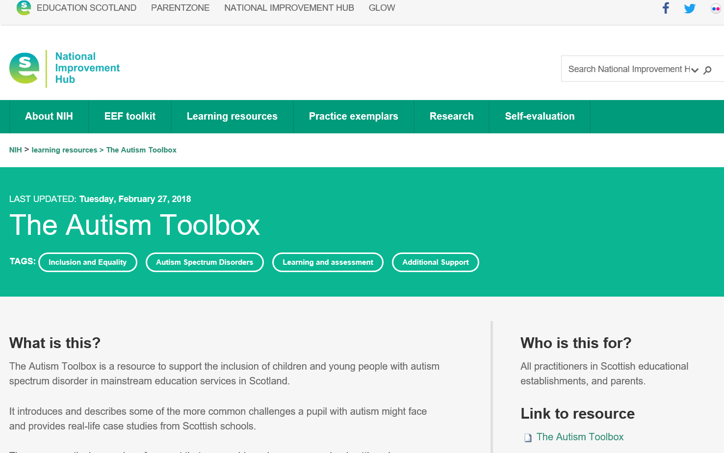
Notes:
Key people identified to update the toolbox as required
Includes resources which continue to be added so this section. The Toolbox will continue to grow and develop over time.

