Slide 1
The future of ITE Numeracy Education at Queen Margaret University
Sandra Eady & Chris Green

Slide 2
Overview of numeracy through
Initial Teacher Education

Slide 3
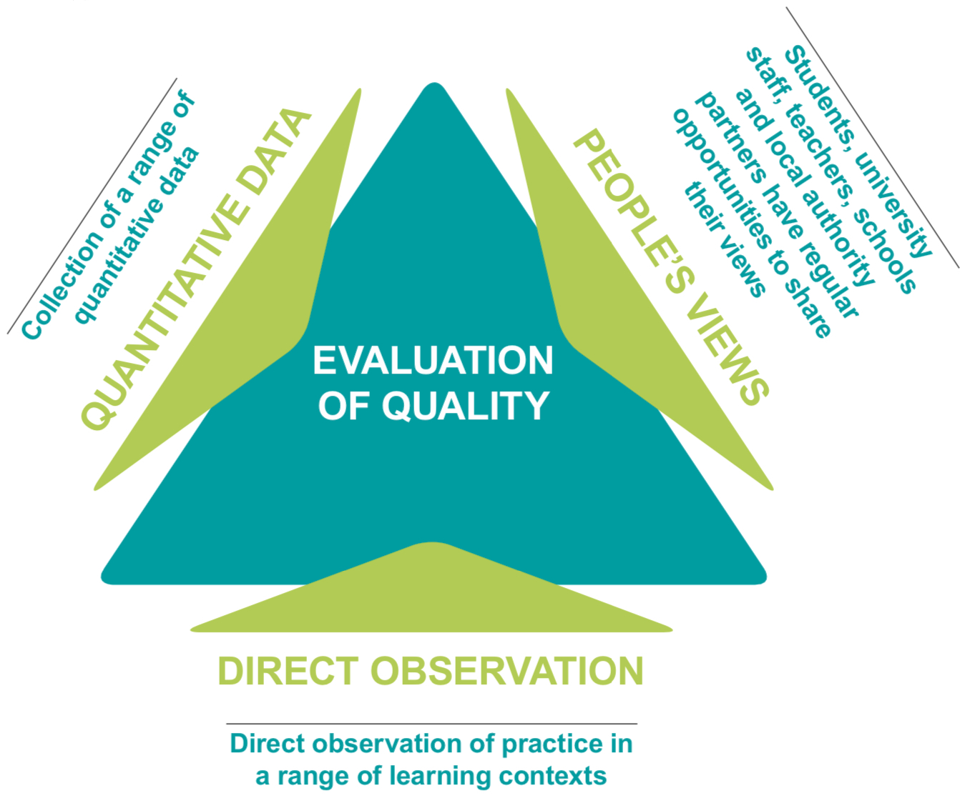
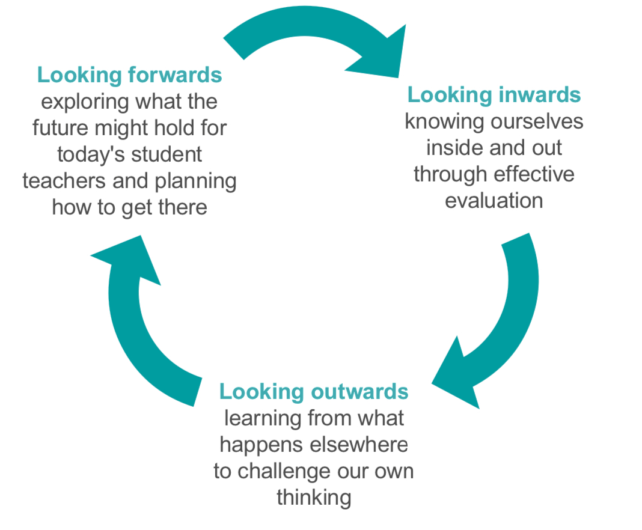
Building Initial Teacher Education
(Self evaluation framework for ITE, 2018)
Enhancement theme:
Evidence for Enhancement: Improving the Student Experience

Slide 4
How do we regularly seek the views of students about their experience to inform our evaluation of our provision?
Developing a focus group from our first cohort - both PGDE & Undergraduate
Student reflection tasks as part of all modules on the online portal
Student representatives from each Seminar group

Slide 5
How are students supported to develop a detailed understanding of their professional responsibilities in relation to numeracy?
Gergonne’s Card Trick

Slide 6
How are students supported to develop a detailed understanding of their professional responsibilities in relation to numeracy?
2.1.4 Have knowledge and understanding of contexts for learning to fulfil their responsibilities in literacy, numeracy, health and wellbeing and interdisciplinary learning
❖ ▪know and understand the content of the curriculum in relation to literacy, numeracy and health and wellbeing as set out in national guidance;
❖ ▪know and understand the methods and underlying theories for effective teaching of literacy, numeracy and health and wellbeing; and select the most appropriate methods to meet all learners’ needs

Slide 7
How are students supported to develop a detailed understanding of their professional responsibilities in relation to numeracy?
PGDE
Specific planned inputs in Reflective and Critical Practice : Getting Ready for Placements
Critical and reflective practice and reflections of how numeracy is embedded in Home Economics

Slide 8
Undergraduate:
1st year:
Also includes inputs of numeracy and it’s place within CfE
Academic Literacies supports students to consider their own level of numeracy and develop an action plan to address gaps

Slide 9
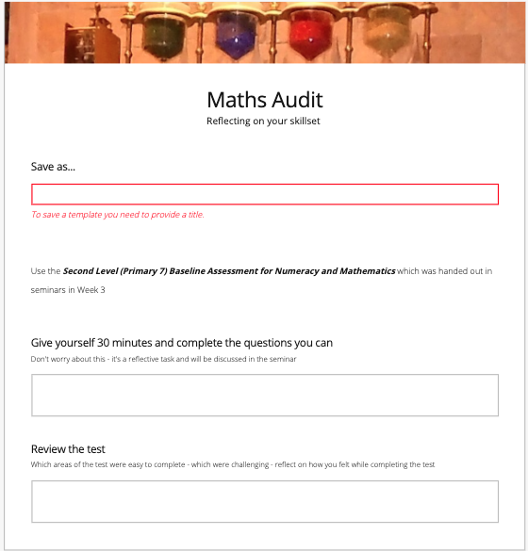
Maths Audit
Reflecting on your skillset
Using the Second Level (Primary 7) Baseline Assessment for Numeracy and Mathematics.
Give yourself 30 minutes and complete the questions you can.
Don't worry about this - it's a reflective task and will be discussed in the seminar.
Review the test.
Which areas of the test were easy to complete - which were challenging - reflect on how you felt while completing the test.

Slide 10
2nd year:
Core numeracy module, building on personal action plan and PCK for numeracy for diverse learners and the role of digital technologies
Mathematics & numeracy: theory and pedagogy
‘A group presentation on a Maths game’

Slide 11
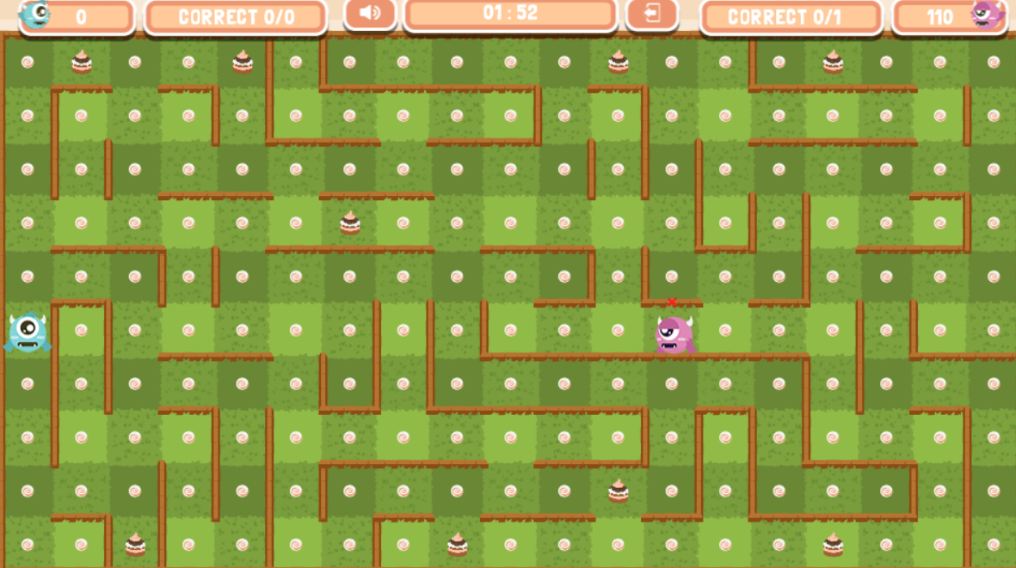
Maths Maze Monsters
Notes:
https://mathsframe.co.uk/en/resources/resource/468/Maths-Maze-Monsters-Multiplication

Slide 12
3rd year:
Core numeracy continues to develop personal action plan and build confidence and competence regarding data literacy
Set within a problem solving framework and IDL links are emphasised
Everyday life contexts: A problem solving approach to mathematics
Interdisciplinary Learning project to create and demonstrate live or on video

Slide 13
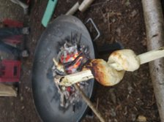
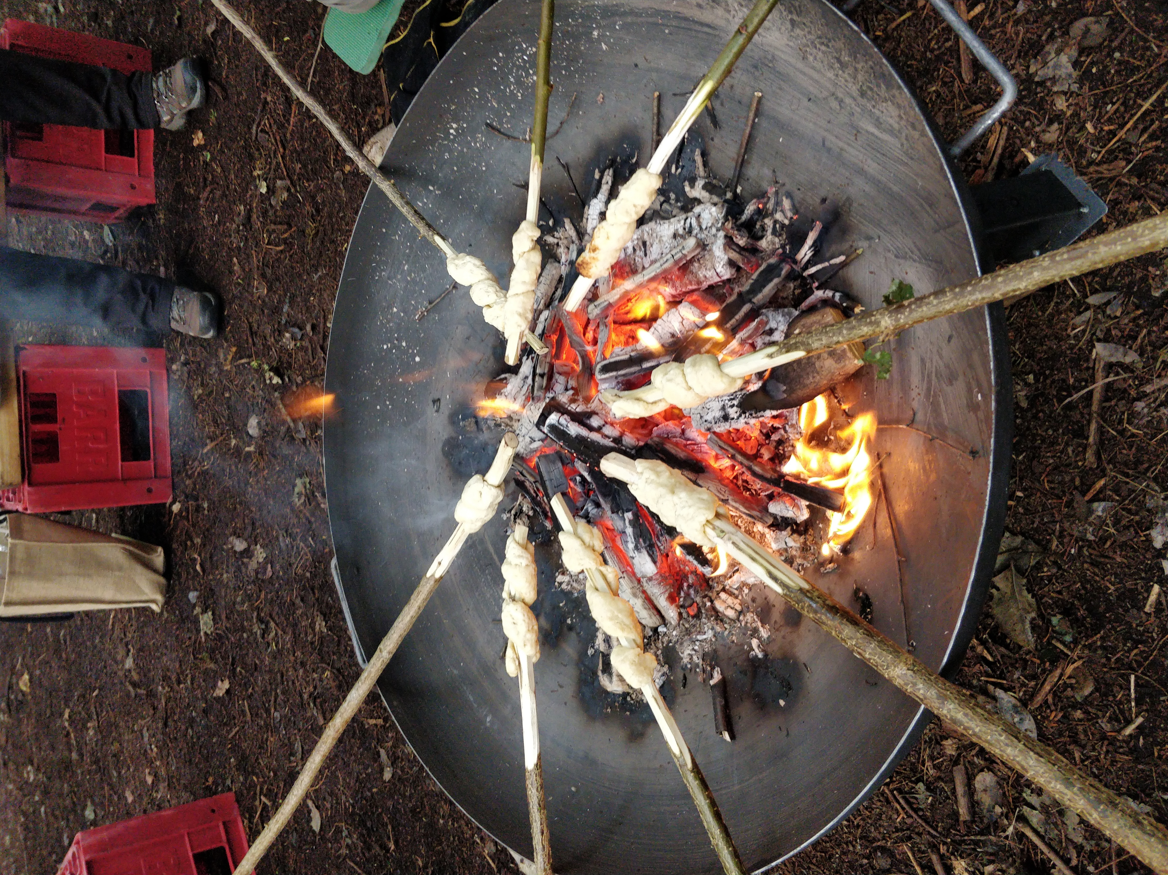
Damper Bread
It's an American recipe – 1 cup = 128g / 268ml
Ingredients:
4 cups of self-raising flour (512g)
Pinch of salt
½ Cup caster sugar (64g)
½ Cup Milk (134ml)
½ Cup sunflower oil (134ml)
2 eggs
To cook:
Add the oil, milk and eggs to the dry ingredients in a large zip lock bag (Removes the need to touch ingredients)
Squidge into a dough
Take a golf ball size piece of mixture and roll into a sausage shape
Wrap around a de-barked stick (such as hazel / willow)
Hole over the campfire and turn gently

Slide 14
How do our students demonstrate specific understanding of effective teaching approaches in numeracy?
During placements
Through online portfolio tasks - reflective, reading, analysis
Practical teaching opportunities

Slide 15
How do we liaise effectively with local authorities and schools to ensure a coherent learning experience for all students?
Regular meeting with Local Authorities since the development of the undergraduate and postgraduate programmes
Undergraduate
Specific meeting to focus on coherency of numeracy and mathematics strand over 4 year programme, looking at progression of university inputs and what students would be expected to do on each block of school experience in numeracy.
Local Authorities’s were invited to bring numeracy specialists to input at this session.
Planned to continue as part of review and reflection as programme develops

Slide 16
How do we liaise effectively with local authorities and schools to ensure a coherent learning experience for all students?
Regular interaction with local Primary Schools, Secondary schools and Independent Schools
Appointment of a numeracy lead at university, prior to consultation with numeracy specialists at Stirling University, Napier University, Glasgow University (D&G campus) and Mathematics network group

Slide 17
Our students are developing their practice to understand, and take appropriate account of, additional support needs and socio-economic factors which may act as barriers to learning for children and young people.

Slide 18
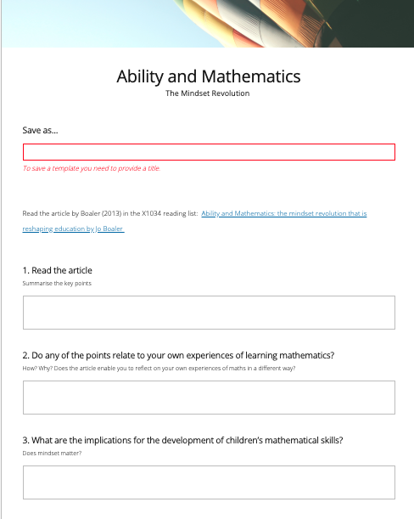
Ability in Mathematics:
The Mindset Revolution that is reshaping education.
(Boaler, 2013)
1. Read the article. Summarise the key points
2. Do any of the points relate to your own experiences of learning mathematics?
How? Why? Does the article enable you to reflect on your own experiences of math's in a different way?
3. What are the implications for the development of children’s mathematical skills?
Does mindset matter?

